Slide 1
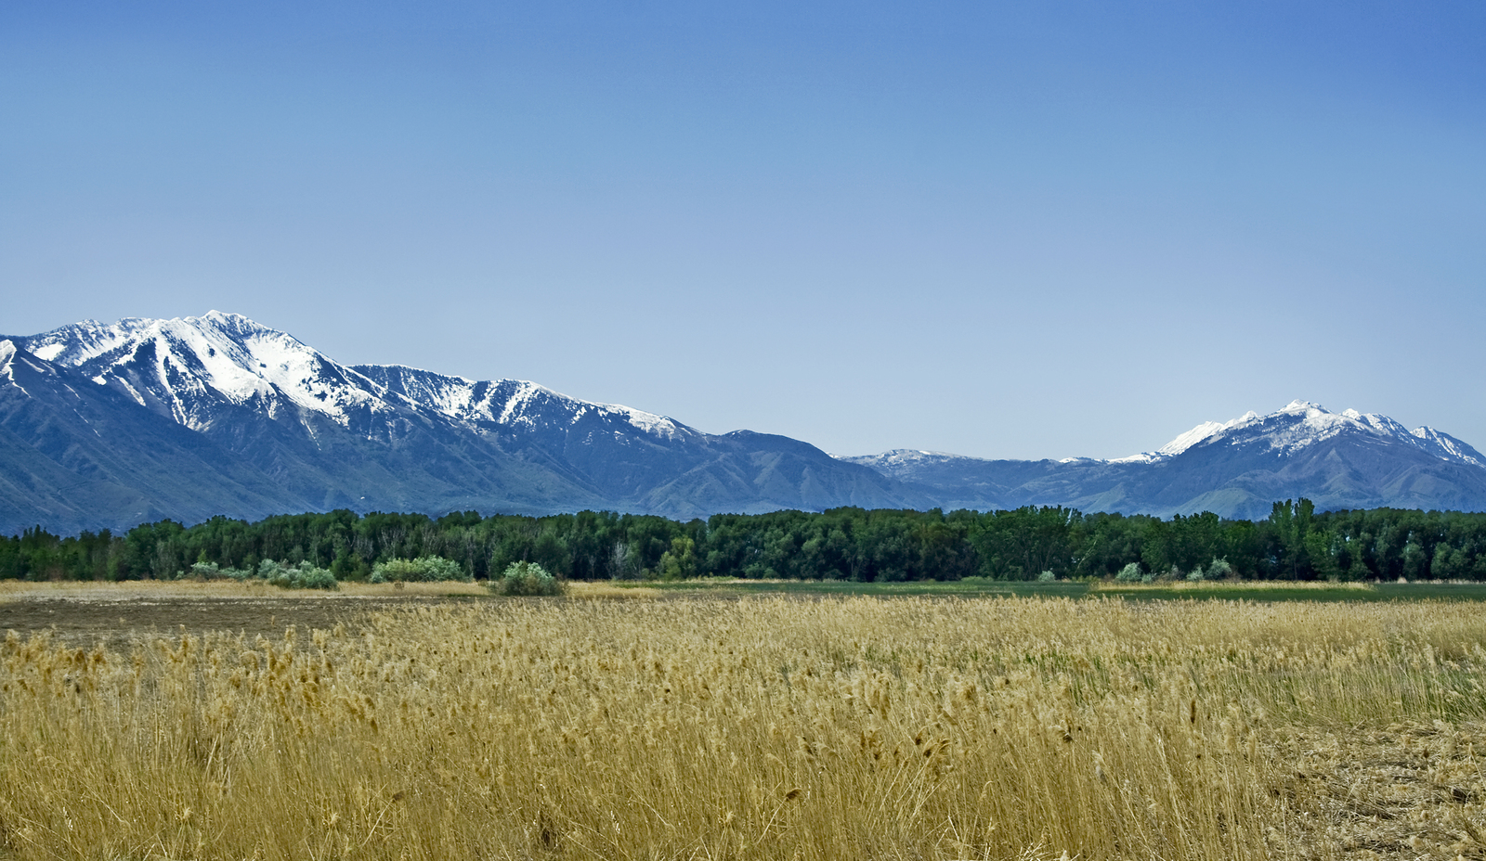
The Long-Term Unemployed in Montana May 19th, 2021
Nick Holom,
Economist

Slide 2
Effects of Longer Unemployment Duration
Long-term unemployed = unemployed six months or longer
Loss of skills, loss of work connections, and material hardship
Workers unemployed eight months are half as likely to get a callback (Quarterly Journal of Economics. Kroft et al. 2013)
During 2009 Recession
Half of the long-term unemployed had family income decrease by 40% or more (Urban Institute. Johnson and Feng 2013)
A third of the long-term unemployed stopped looking for work after 21 months (Brookings Institute. Krueger et al. 2014)

Slide 3
COVID-19 Recession May Be Different
Per capita income increased from $49,600 to $59,000 (MTDLI. Amy Watson 2021)
UI benefits reduced financial hardship (Urban Institute. Karpen and Arcs 2020)
Work disincentive
Enhance benefits increased unemployment rate by 3.7 percentage points (Federal Reserve Bank of Kansas City. Fang et al. 2020)
10,800 Montanans still not working due to virus risk (Census Pulse Survey. March 2021)

Slide 4
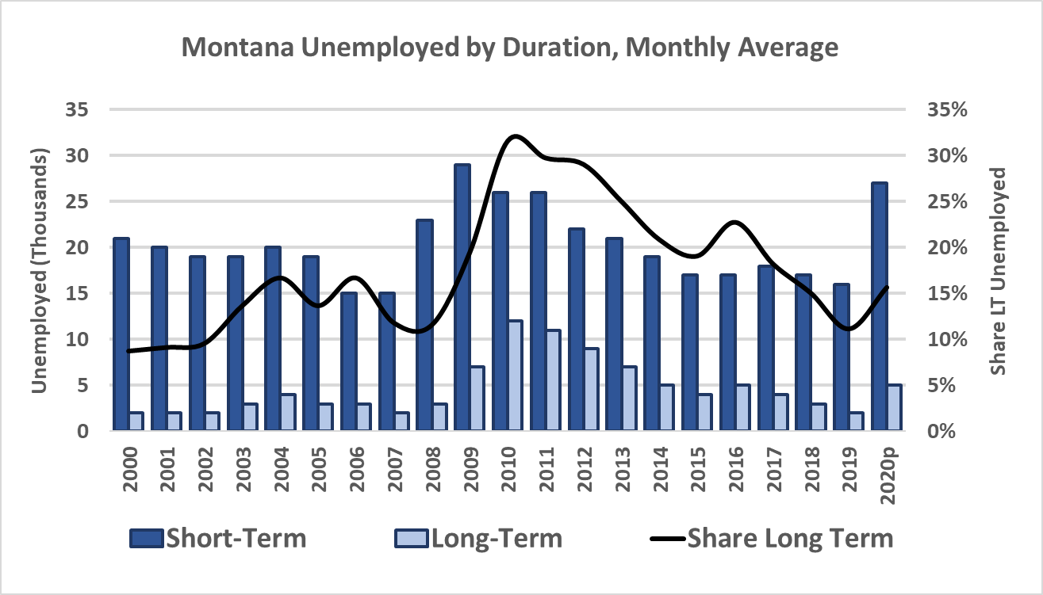
Long-term Unemployment in Montana
Source: BLS CPS unemployment by duration. 2020 data is preliminary.

Slide 5
Long-Term UI and PUA Claimants
Source: MTDLI unemployment claims data

Slide 6
Long-Term Claimants Are More Often Women
Source: MTDLI unemployment claims with first benefit week before 10/03/2020. Excludes PUA.

Slide 7
Long-Term Claimants Are Older
Source: MTDLI unemployment claims with first benefit week before 10/03/2020. Excludes PUA.

Slide 8
Long-Term Claimants Are Lower Wage
Source: MTDLI unemployment claims with first benefit week before 10/03/2020. Excludes PUA.

Slide 9
Seasonal Industries Have Longer Median Duration
Source: MTDLI unemployment claims data from 1/1/2020 to 4/3/2021 with first benefit week before 10/03/2020.

Slide 10
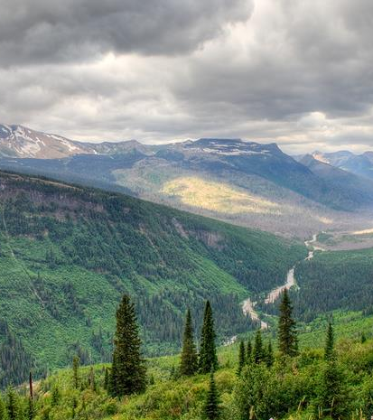
More Information at lmi.mt.gov
Nick Holom
Economist
MT Dept. of Labor and Industry
nicholas.holom@mt.gov
406-444-4125

