Slide 2
COVID Programs Ending June 26, 2021
Federal Pandemic Unemployment Compensation (FPUC)
Pandemic Unemployment Assistance (PUA)
Pandemic Emergency Unemployment Compensation (PEUC)
Mixed Earners Unemployment Compensation (MEUC)
Reminders:
File for benefits as you normally would following the week ending 06/26/2021
Check your dashboard to determine what programs you are currently participating in
Claimants are required to conduct a weekly work search and report it on your weekly payment request unless the Department has notified you otherwise.
Eligibility requirements will be applied based on pre-pandemic criteria:
Separation from work
Able and Available for work
Job Service Montana can assist you with work search efforts

Slide 3
Federal Pandemic Unemployment Compensation (FPUC)
FPUC currently provides an additional weekly benefit of $300 if you are eligible to receive at least $1 in regular unemployment benefits for a certified week.
Applies to regular Unemployment and PUA claimants.
Beginning June 27, 2021, the State of Montana will no longer participate in the FPUC program.
Benefit payments filed for weeks prior to and including the week ending June 26, 2021, will include the FPUC payments if you are found eligible.
Regular Unemployment Compensation rules will apply going forward.

Slide 4
Pandemic Unemployment Assistance (PUA)
PUA - self-employed, those not eligible for UI Benefits or those whose employment was impacted as the result of COVID-19
Beginning June 27, 2021, the State of Montana will no longer participate in the PUA program.
Benefit payments filed for weeks prior to and including the week ending 06/26/2021, will be paid if you are found eligible.
Federal Pandemic Unemployment Compensation (FPUC) ends 06/26/2021
As mentioned previously this program will not be available beginning 06/27/2021.

Slide 5
Pandemic Emergency Unemployment Compensation (PEUC)
PEUC provides an extension of your Unemployment Insurance claim, adding additional weeks of benefits for claimants who have exhausted their UI claim and are not eligible to file a new claim.
Beginning June 27, 2021, the State of Montana will no longer participate in the PEUC program.
Benefit payments filed for weeks prior to and including the week ending 06/26/2021, will be paid if you are found eligible. Claimants who have exhausted their regular UI benefits will no longer be eligible for payments.
Regular Unemployment Compensation rules will apply going forward.

Slide 6
Mixed Earners Unemployment Compensation (MEUC)
MEUC provides an additional $100 per week paid to claimants who have been eligible for regular unemployment benefits, but also earned at least $5,000 in self-employment net income in their most recent taxable year.
Beginning June 27, 2021, the State of Montana will no longer participate in the MEUC program.
Benefit payments filed for weeks prior to and including the week ending 06/26/2021, will be paid if you are found eligible.

Slide 7
Filing for the Week of June 26th
When requesting payment for the last week of the FPUC/PEUC/PUA/MEUC programs, you won’t do anything different with filing your request
The week will be issued if you are eligible in the normal way the other weeks you requested payment were.
You don’t need to change anything or do anything different

Slide 8
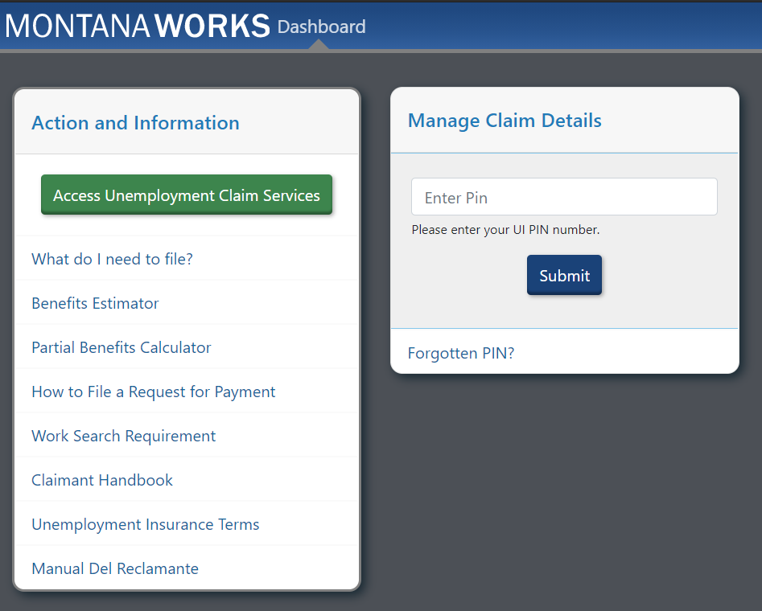
MontanaWorks Dashboard

Slide 9
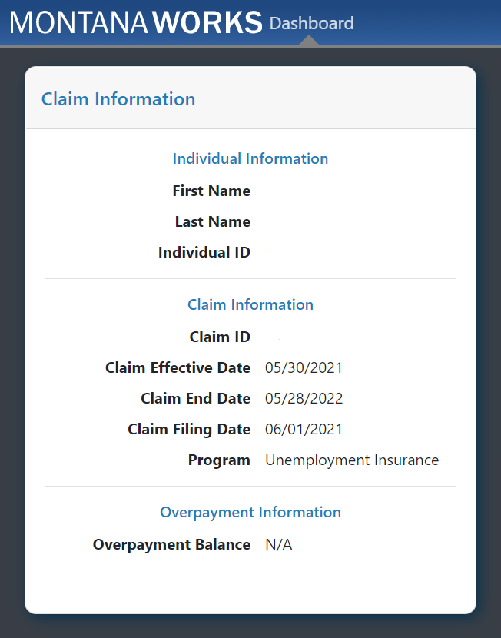

Slide 10
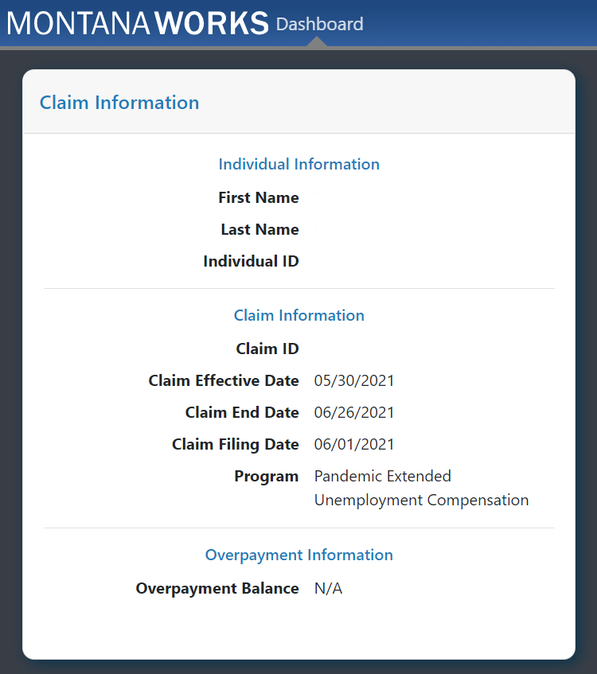

Slide 11
Able, Available & Actively Seeking Employment
Beginning 06/27/2021, pre-pandemic eligibility requirements will be applied.
As a reminder:
Claimants are required to conduct a weekly work search and report it on your weekly payment request unless the department has notified you otherwise.
Eligibility requirements will be applied based on pre-pandemic criteria:
Separation from work
Able and Available for work

Slide 12
Job Attachment
Unemployment Insurance notifies you when your work search requirements have been waived.
A common reason for work search waiver is job attachment.
This means you have an approximate date of hire, or return to work, at 30 or more hours per week. You must still be able and available for work and report separations from any employment.
Job Attachment may be verified with your employer.
If you accept an offer of employment but will not start right away, call Claims Processing immediately.

Slide 13
What is considered a work search:
Applications must be made within the week you are requesting payment
Applying for a job includes completing a job application, submitting a resume, or attending a job interview.
Work search contacts need to be made with the person who has hiring authority and the employer must pay into Unemployment Insurance.
Work search contacts must be work you are willing to do, qualified to do and in an area, you are willing to work.
Registering with a temporary hiring agency can only be considered a work search for one week of the Claim Year.
Include the business name, the person contacted, date of contact, the position you applied for, the telephone number of the business, the URL if an internet application, and the result of the contact.

Slide 14
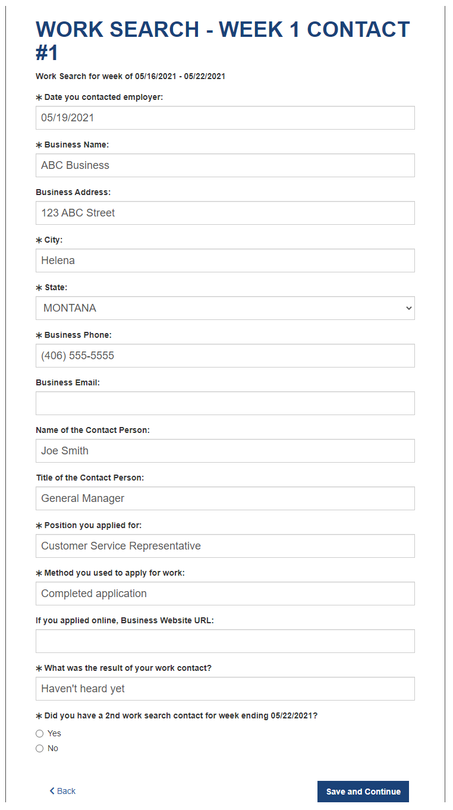
Work Search Examples

Slide 15
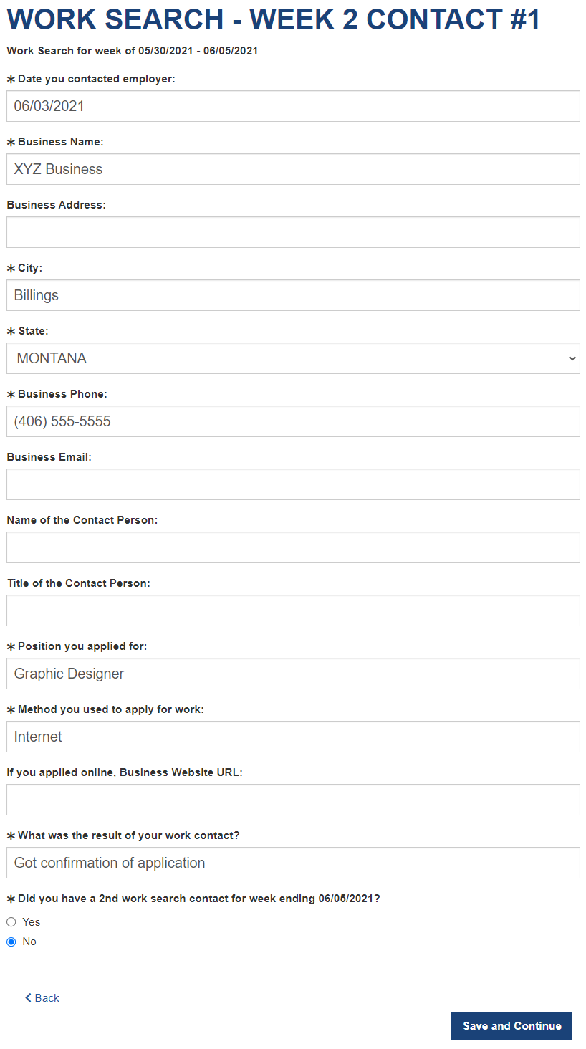
Work Search Examples

Slide 16
Job Service Info
Many employers are ready to hire, and Job Service Montana is ready to help you. The Job Service team is knowledgeable about jobs in your community and can help with training for a new career or connect you with other helpful resources.
For more information, please visit: https://montanaworks.gov/job-service-montana
Or email:
DLI.JobServiceMT@mt.gov.

Slide 17
Return to Work
Using federal COVID-19 stimulus funds designated for Montana,
the Return-to-Work Bonus Initiative seeks to help remedy Montana’s immediate need for workers by incentivizing workers to rejoin the labor force, accept employment and remain employed.
For information about the program please visit: https://montanaworks.gov/rtw
Or email:
DLIRTW@mt.gov.

Slide 18
Resources:
Frequently Asked Questions:
https://uid.dli.mt.gov/benefits-changing
Claimant Handbook:
https://uid.dli.mt.gov/_docs/claims-processing/claimant-handbook.pdf
Return to work information:
https://montanaworks.gov/rtw
DLIRTW@mt.gov.
Job Service Information :
https://montanaworks.gov/job-service-montana
DLI.JobServiceMT@mt.gov.

