Slide 1


Slide 2
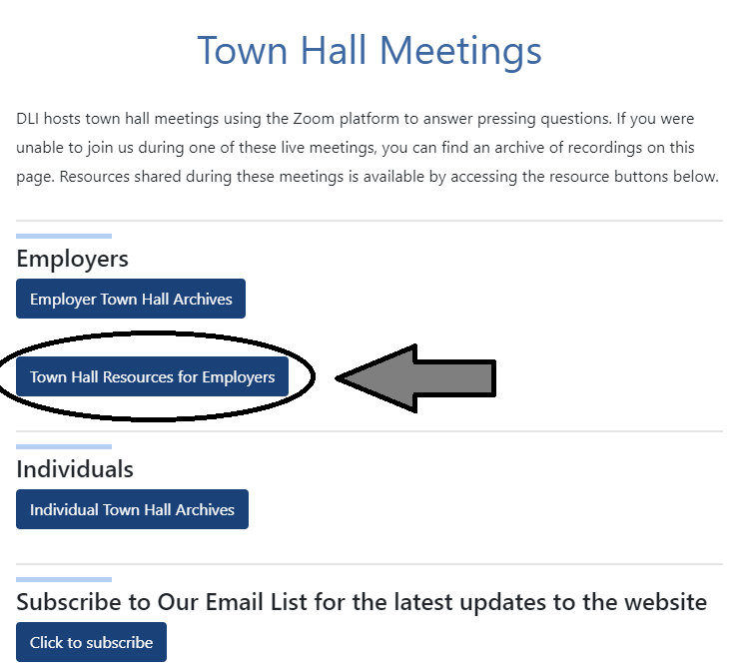
https://dli.mt.gov/covid-19/town-halls/

Slide 3
DLI Workforce Resources
For all employment and training questions
Email DLI.JobServiceMT@mt.gov
Employers can get help with recruiting, hiring, and staff training
Workers can get help with job prep, job search, training, and more
Tools
Employers POST jobs at
https://bit.ly/3u4ijWK
Workers SEARCH jobs at
https://montanaworks.gov/job-search?keyword=&location=
Job Service Montana: https://montanaworks.gov/job-service-montana
Notes:
The Human Rights Bureau is the state agency charged with enforcement of the Montana Human Rights Act and the Governmental Code of Fair Practice. Through a contract with the federal government, the Bureau also processes employment discrimination claims filed under Title VII of the Civil Rights Act of 1964, the Americans with Disabilities Act, and the Age Discrimination in Employment Act. We are the first step in a multi-level administrative process that handles complaints of discrimination. Someone who is considering suing for discrimination must exhaust the administrative process before a court will hear their case. The Bureau is a NEUTRAL ENTITY - it does not represent Charging Parties nor does it defend Respondents, the Bureau’s fidelity is to the law it is charged to enforce
The Bureau’s main function is to conduct independent and neutral investigations into complaints of discrimination. It is important to understand that the Bureau does not get to turn away a complaint that is filed, we are obligated by statute to conduct an investigation. (I’ll talk more about our investigations in a minute.) Complaints come to our Bureau in three ways: (1) the Bureau’s intake process, which is an hour long telephone appointment with an investigator to discuss whether or not a caller’s situation falls within the laws enforced by the Bureau; (2) a self-drafted complaint; or (3) attorney drafted complaint.
HRB also provides mediation services –voluntary and confidential.
Lastly, HRB offers education to the public: employers, employees, students, tenants, housing providers and other interested parties throughout the state. This is a preventative effort to further awareness of nondiscrimination laws.

Slide 4
Learn More Here
Montana Labor Market Information
https://lmi.mt.gov/
Research and Analysis Bureau
Barbara Wagner –Economist
bwagner@mt.gov
406-444-5474
Nicholas Holom – Economist
nicholas.holom@mt.gov
406-444-4125
Amy Watson – Economist
awatson@mt.gov
406-444-3245

