Slide 2
Employer Town Hall Learn how Registered Apprenticeship can work for you
Kathleen o’leary
Kristy Ferguson
Myles Hickman
James Lane
Mark Lillrose

Slide 3
Mark Lillrose
DLI Registered Apprenticeship Program
(406) 444-1641
mlillrose@mt.gov
http://apprenticeship.mt.gov

Slide 4
Kristy Ferguson
Beyond the Box
(406) 245-6981
kristy@btbcabinets.com
https://www.btbcabinets.com

Slide 5
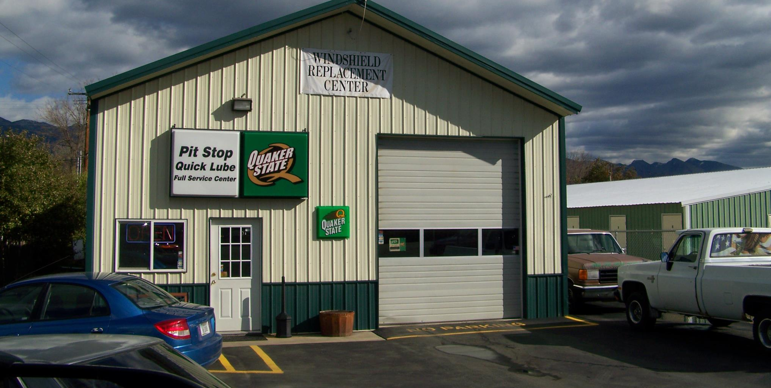
Myles Hickman
The Pit Quick Lube, Inc.
(406) 291-1071
mhickman@interbel.com
https://www.facebook.com/Eurekapitstop

Slide 6
James Lane
OHS’ Body Shop
(406)752-8202 ext 233
vp@ohsbody.com
https://ohsbodyshop.com

Slide 7
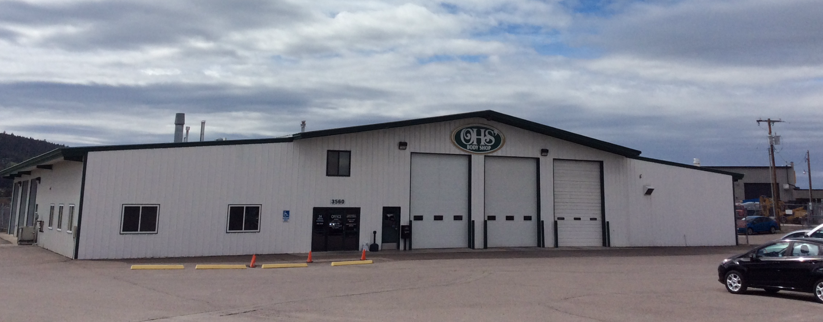
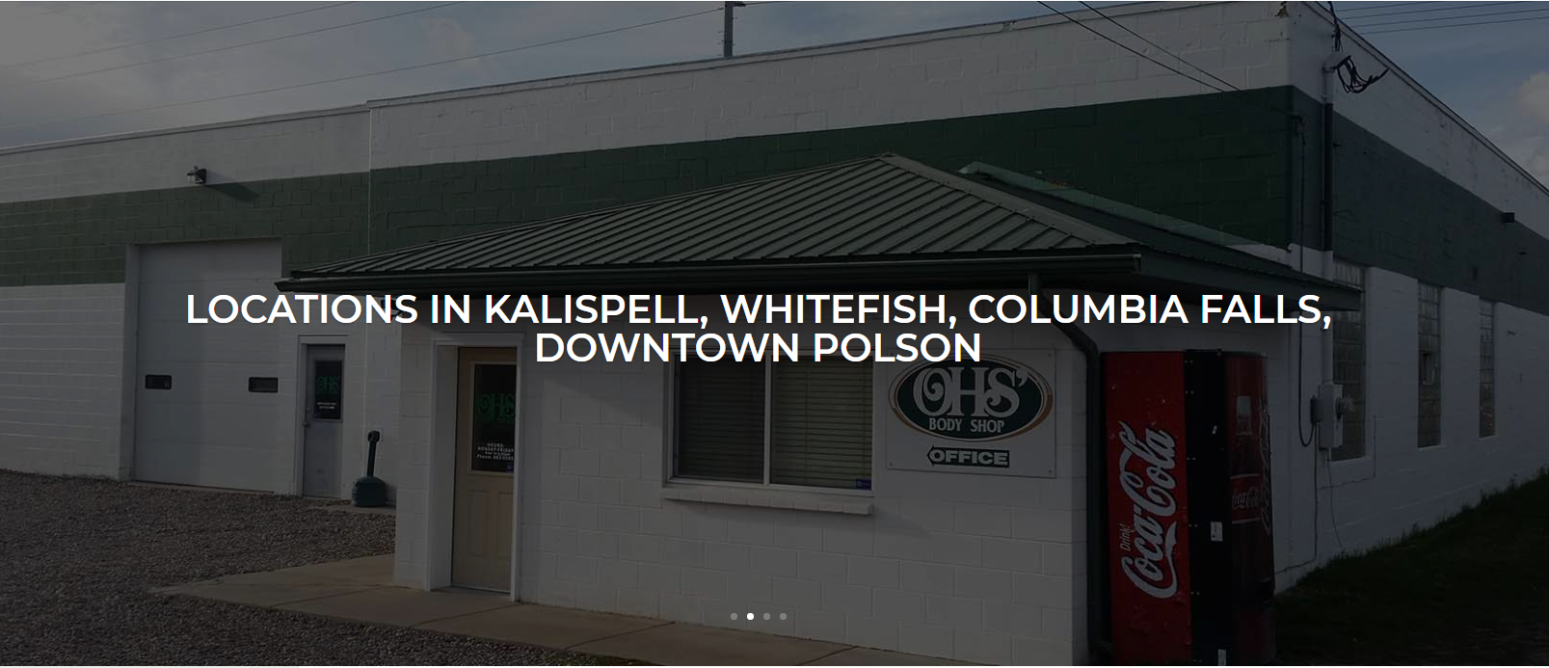

Slide 8
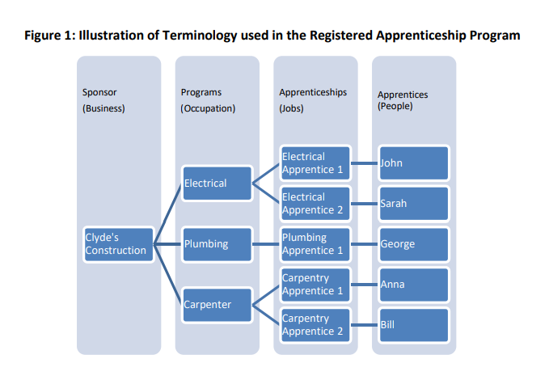
Registered Apprenticeship Program Data Report: http://lmi.mt.gov/Publications/registered-apprenticeship-program-data-report-1

Slide 9
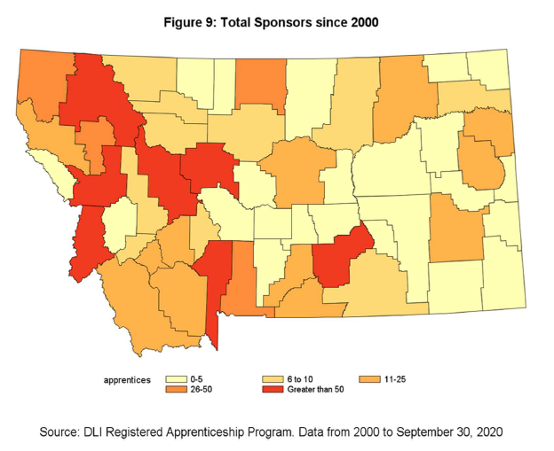

Slide 10
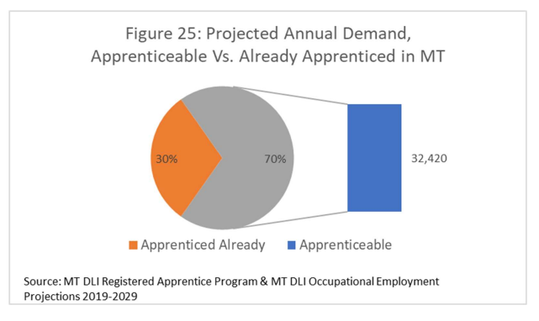

Slide 11
Highlights include:
Apprenticeships contribute to the economic success of Montana’s workers. A year after graduation, apprentices had an average wage of $58,086, nearly $11,600 higher than the statewide average wage.
Apprenticeships help retain skilled workers in Montana. Approximately 84% of apprentices who graduated before 2015 were still working for a Montana employer five years later.
Apprentices were trained in 82 different occupations in 2019, and over 110 occupations have been apprenticed in Montana. Montana Registered Apprenticeship staff assists interested employers in establishing apprenticeships in new fields.
In 2019, 77% of apprentices were between the ages of 16 and 34, suggesting that work-based learning in the form of apprenticeship is becoming a well-known option for young adults to pursue directly after high school.
The share of women in apprenticeships has increased over the past five years, from 4.4% in 2015 to21.3% in 2019. Most of this growth has occurred in apprenticeships for certified nursing assistants, medical coding, and child care workers.

