Slide 1

Impacts of Child Care on the Montana Workforce
AMY WATSON, Senior Economist
May 19th, 2021

Slide 2
Child Care is a Workforce Issue
An estimated 6% of the labor force relies on child care to remain employed.
Yet
Licensed child care capacity meets only about 47% of the estimated demand.
Source: DPHHS child care licensing data as of 7/20. Montana Dept of Commerce, CEIC population data. 2014-2018 ACS 5-Year Estimates.

Slide 3
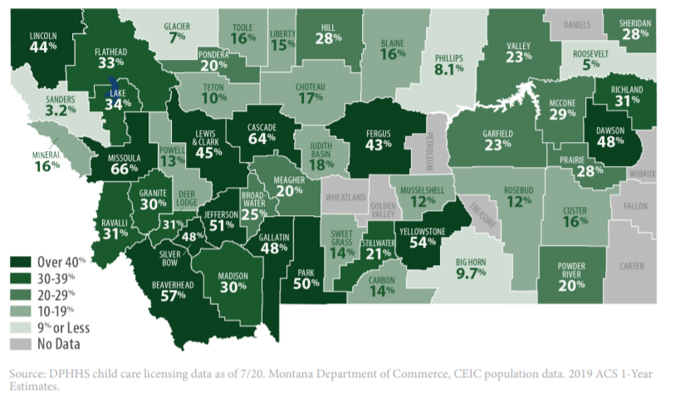
Shortages Across the State
Source: DPHHS child care licensing data as of 7/20. Montana Dept of Commerce, CEIC population data. 2014-2018 ACS 5-Year Estimates.
Notes:
Childcare capacity varies significantly by county, with urban counties generally having greater access to licensed care. Eight of Montana’s counties do not have a single licensed provider and 77% are considered childcare deserts, where supply meets less than a third of estimated demand (as of July 2020).

Slide 4
2020 – COVID Impacts
Drop in licensed child care capacity
43% of providers closed in April 2020
14% of providers closed in June 2020
Approximately 25,000 Montanans are unable to return to work due to a lack of childcare/ need to monitor at-home-learning.
55,000 Montana parents working reduced hours – which accounts for 10% of the labor force.
Source: DPHHS Early Childhood Services Bureau. Nov 2020 Local Area Unemployment Statistics. 2020 CPS IPUMS data complied by MTDLI.
Notes:
The state’s childcare shortage was dramatically impacted by the COVID pandemic. In April 43% of providers closed as an immediate response to the pandemic and the public health guidelines aimed at limiting the spread of COVID-19. However, many providers were able to adapt and reopen within a few months. By June only 14% of providers remained closed. However, many of the providers were opened at limited capacity, leaving many Montana parents without reliable childcare.
Estimated 25,000 Montana parents are unable to return to work, are working part-time, or missed work in the last week due to a lack of childcare. Additionally, about 55,000 parents are working reduced hours. This could mean working 30 instead of 40hr weeks, or taking entire weeks off work intermittently (using leave, etc.) to care for children or monitor remote learning. For example, if there is a positive COVID case at a childcare facility the provider will likely close for 2 weeks. With limited advanced noticed, many parents are unable to arrange backup care.

Slide 5
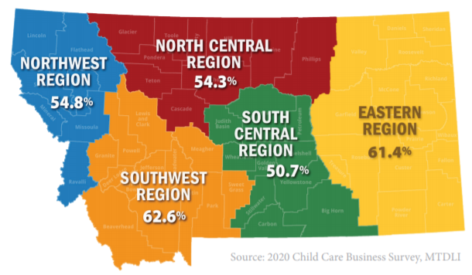
Business Impacts Percent of Businesses Identifying Lack of Child Care
57% of businesses identify a lack of affordable child care in their community,
and
60% stated improving access to child care should be a priority for their community.
Notes:
These data come from the business survey conducted in the first quarter of 2020 in partnership with the Federal Reserve Bank of Minneapolis. Thank you to all the employers who complete the survey. The results have been instrumental in better understanding the workforce impacts of childcare in Montana.

Slide 6
Business Impacts
40% of businesses report difficulty recruiting or retaining qualified workers due to a lack of affordable child care in their community.
30% of Montana businesses say inadequate child care has prevented their company from growing.
Disproportionately impacts female workforce.
Source: 2020 Child Care Business Survey, MTDLI
Notes:
Businesses with a predominantly female workforce were more likely to report a lack of affordable child care in their community. 70% of these businesses stated there was a lack of child care in their community, and at least 50% reported an impact on recruitment or retention

Slide 7
Child Care Benefits
Flexible Work Arrangements (75%)
Paid Parental Leave (13%)
Mothers (7 weeks) have more leave than fathers (4 weeks)
Dependent Care Assistance Plans (15%)
Increased Access to Care
HR policies (3.8%)
onsite child care (2.6%)
backup child care (1.3%)
subsidized child care, coop, and reserve spaces (<1%)
Source: 2020 Child Care Business Survey, MTDLI
Notes:
Three-quarters of Montana businesses offered flexible work arrangements, which can help employees adapt their work schedule based on child care availability. The most common type of arrangement reported was flexible scheduling (59%), followed by the option to temporarily reduce hours (41%) and advanced scheduling (27%).
On average, Montana families pay $7,900 annually for child care, which is 14% of the state’s median family income. To help offset these costs, 15% of Montana businesses offered Dependent Care Assistance Plans (DCAP). Businesses in Finance and Insurance, Utilities, and Information industries offer DCAP at significantly higher rates. Over 47% of firms in these industries offered DCAP plans to their employees.

Slide 8

More info available at lmi.mt.gov
Amy Watson
Senior Economist
MT Dept. of Labor and Industry
awatson@mt.gov

