Slide 1


Slide 2
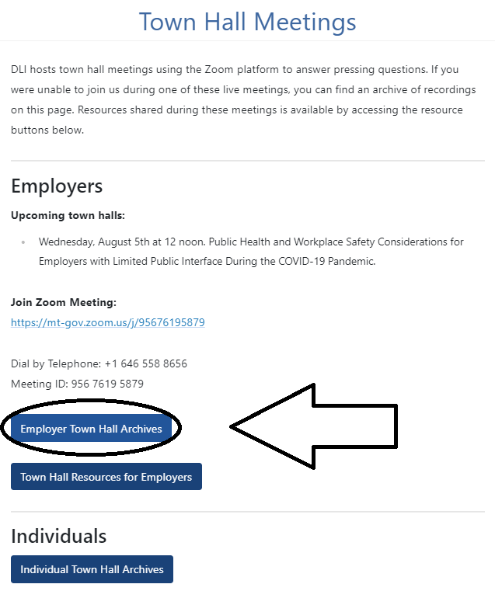
https://dli.mt.gov/town-halls

Slide 3
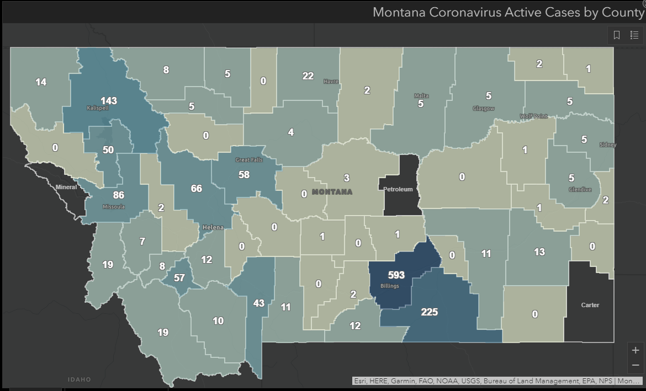
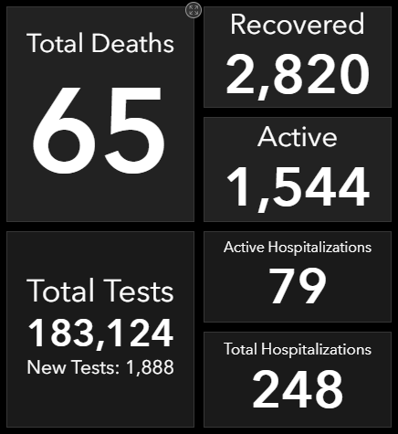
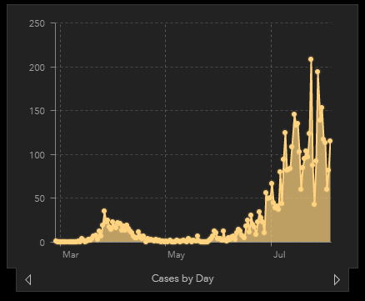
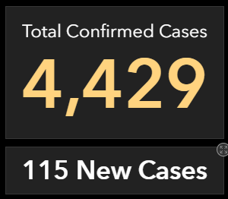
https://dphhs.mt.gov/publichealth/cdepi/diseases/coronavirusmt/demographics
As of 10:00 AM 8/5/2020

Slide 4
Governor Steve Bullock Directives
Providing For the Mandatory Use of Face Coverings in Certain Settings https://dphhs.mt.gov/Portals/85/Documents/NewsLetters/MaskDirective.pdf
Establishing Conditions for Phase Two https://covid19.mt.gov/Portals/223/Documents/Phase%20Two%20Directive%20with%20Appendices.pdf?ver=2020-05-19-145442-350
Occupational Safety and Health Administration (OSHA)
OSHA Guidance on Preparing Workplaces for COVID-19 https://www.osha.gov/Publications/OSHA3990.pdf
OSHA Control and Prevention https://www.osha.gov/SLTC/covid-19/controlprevention.html

Slide 5
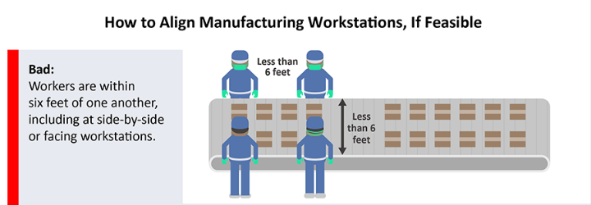
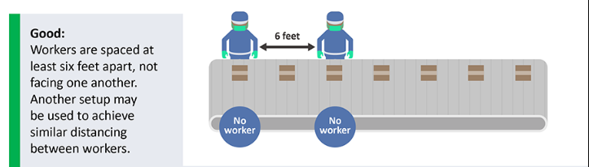
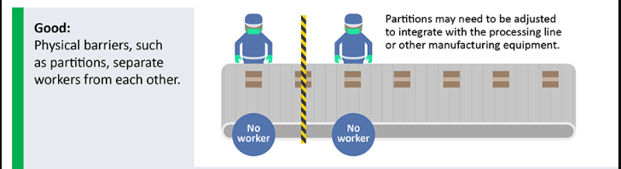
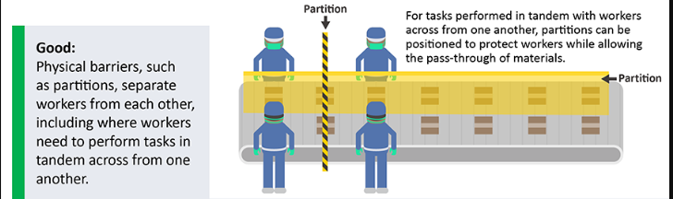
https://www.cdc.gov/coronavirus/2019-ncov/images/community/manufacturing-workstations-alignment.png

Slide 6
Center for Disease Control and Prevention (CDC)-Health
Symptoms https://www.cdc.gov/coronavirus/2019-ncov/symptoms-testing/symptoms.html
How It Spreads https://www.cdc.gov/coronavirus/2019-ncov/prevent-getting-sick/how-covid-spreads.html
When to Quarantine https://www.cdc.gov/coronavirus/2019-ncov/if-you-are-sick/quarantine.html?CDC_AA_ refVal=https%3A%2F%2Fwww.cdc.gov%2Fcoronavirus%2F2019-ncov%2Fif-you-are-sick%2Fquarantine-isolation.html
Community-Related Exposures https://www.cdc.gov/coronavirus/2019-ncov/php/public-health-recommendations.html
Washing Cloth Face Coverings https://www.cdc.gov/coronavirus/2019-ncov/prevent-getting-sick/how-to-wash-cloth-face-coverings.html
How to Cope with Job Stress and Build Resilience During The COVID_19 Pandemic https://www.cdc.gov/coronavirus/2019-ncov/community/mental-health-non-healthcare.html?deliveryName=USCDC_10_4-DM27902

Slide 7
Center for Disease Control and Prevention (CDC)- Work
Guidance for Businesses and Employers https://www.cdc.gov/coronavirus/2019-ncov/community/guidance-business-response.html
Cleaning and Disinfection for Community Facilities https://www.cdc.gov/coronavirus/2019-ncov/community/organizations/cleaning-disinfection.html
Ending Home Isolation https://www.cdc.gov/coronavirus/2019-ncov/hcp/disposition-in-home-patients.html
Return-to-Work Criteria https://www.cdc.gov/coronavirus/2019-ncov/hcp/return-to-work.html
Critical Workers https://www.cdc.gov/coronavirus/2019-ncov/community/critical-workers/implementing-safety-practices.html
Employer Information for Office Buildings https://www.cdc.gov/coronavirus/2019-ncov/community/office-buildings.html
Frequently Asked Questions https://www.cdc.gov/coronavirus/2019-ncov/community/general-business-faq.html#Suspected-or-Confirmed-Cases-of-COVID-19-in-the-Workplace
Print Resources https://www.cdc.gov/coronavirus/2019-ncov/communication/print-resources .html?Sort=Date%3A%3Adesc

Slide 8
US Equal Employment Opportunity Commission Guidance https://www.eeoc.gov/wysk/what-you-should-know-about-covid-19-and-ada-rehabilitation-act-and-other-eeo-laws
Disinfectants for Use Against SARS-CoV-2 (COVID-19) https://www.epa.gov/pesticide-registration/list-n-disinfectants-use-against-sars-cov-2-covid-19
Recommendations for Use of Cloth or Disposable Face Coverings (COVID-19) https://acoem.org/acoem/media/PDF-Library/COVID-19-ACOEM-Recommendations-Regarding-Use-of-Face-Coverings-in-the-Workplace-4-10-2020.pdf
FAQs: The ADA, Small Business and Face Mask Policies https://www.gpadacenter.org/faqs-ada-small-business-and-face-mask-policies
Job Accommodation Network (JAN) Accommodation and Compliance (COVID-19) https://askjan.org/topics/COVID-19.cfm
American Industrial Hygiene Association Reopening: Guidance for General Office Settings https://aiha-assets.sfo2.digitaloceanspaces.com/AIHA/resources /GuidanceDocum ents/Reopening-Guidance-for-General-Office-Settings_ GuidanceDocument.pdf
American Society of Heating, Refrigeration and Air-Conditioning Engineers (ASHRAE) Statements on Relationship Between COVID-19 and HVAC in Buildings https://www.ashrae.org/about/news/2020/ashrae-issues-statements-on-relationship-between-covid-19-and-hvac-in-buildings

Slide 9

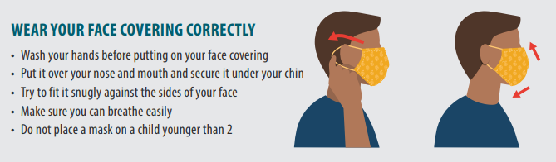
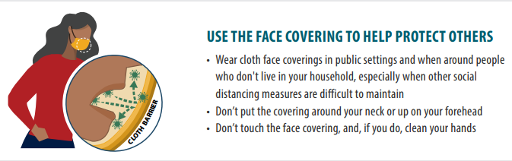
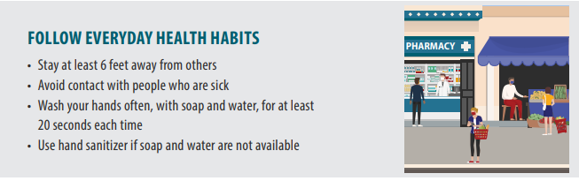
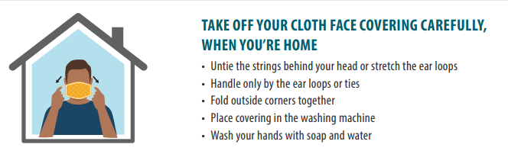
https://www.cdc.gov/coronavirus/2019-ncov/downloads/cloth-face-covering.pdf

Slide 10

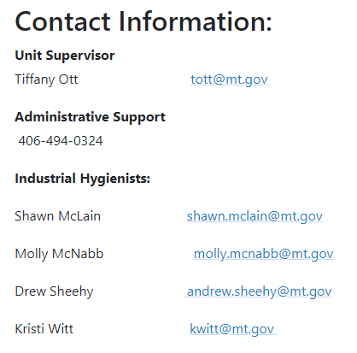
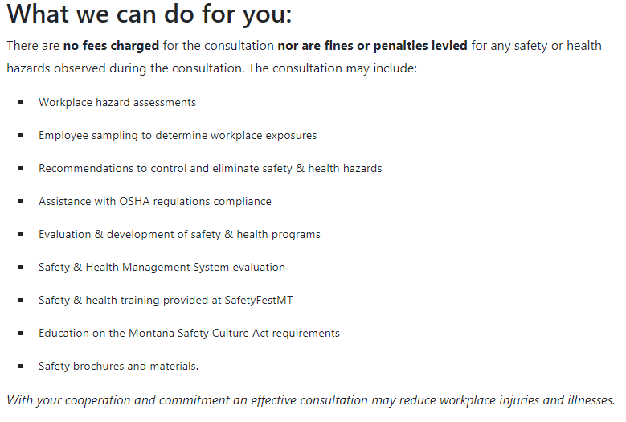
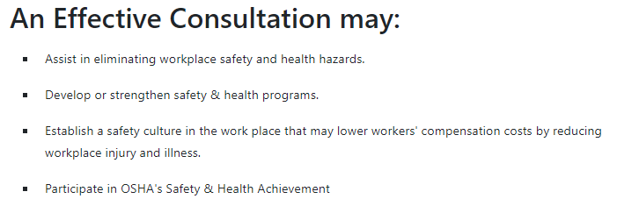
http://erd.dli.mt.gov/safety-health/onsite-consultation

Slide 11
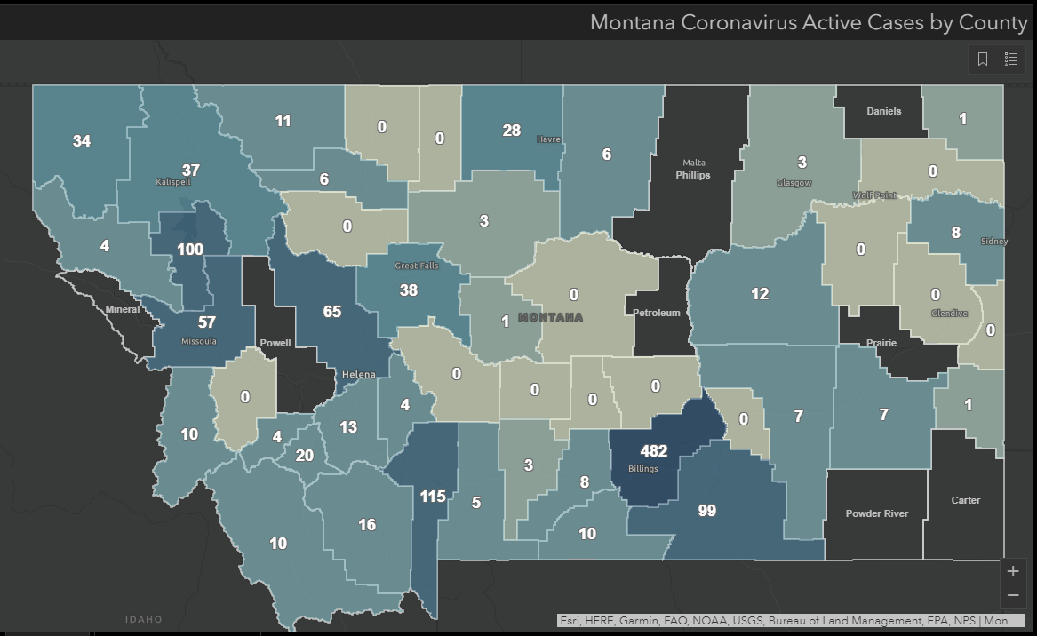
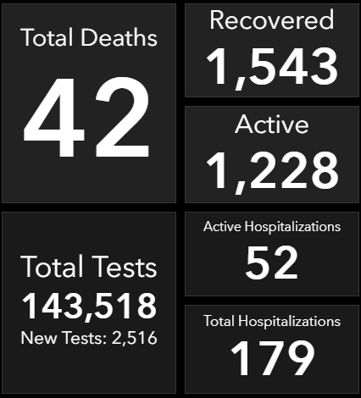
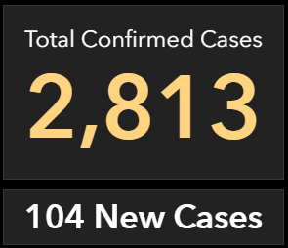
https://dphhs.mt.gov/publichealth/cdepi/diseases/coronavirusmt/demographics
As of 10:20 AM 7/22/2020

Slide 12
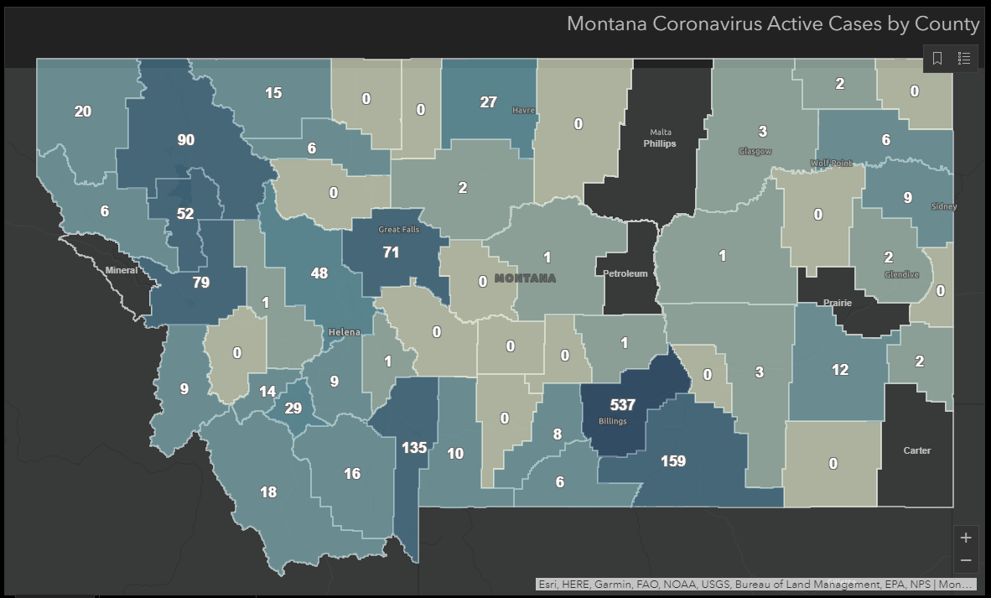
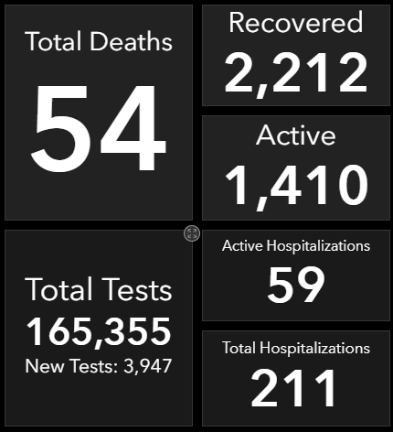
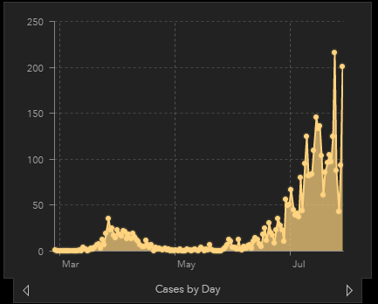
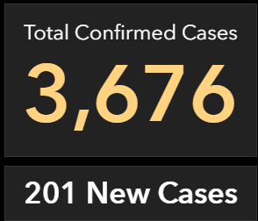
As of 10:00 AM 7/29/2020

