Slide 1
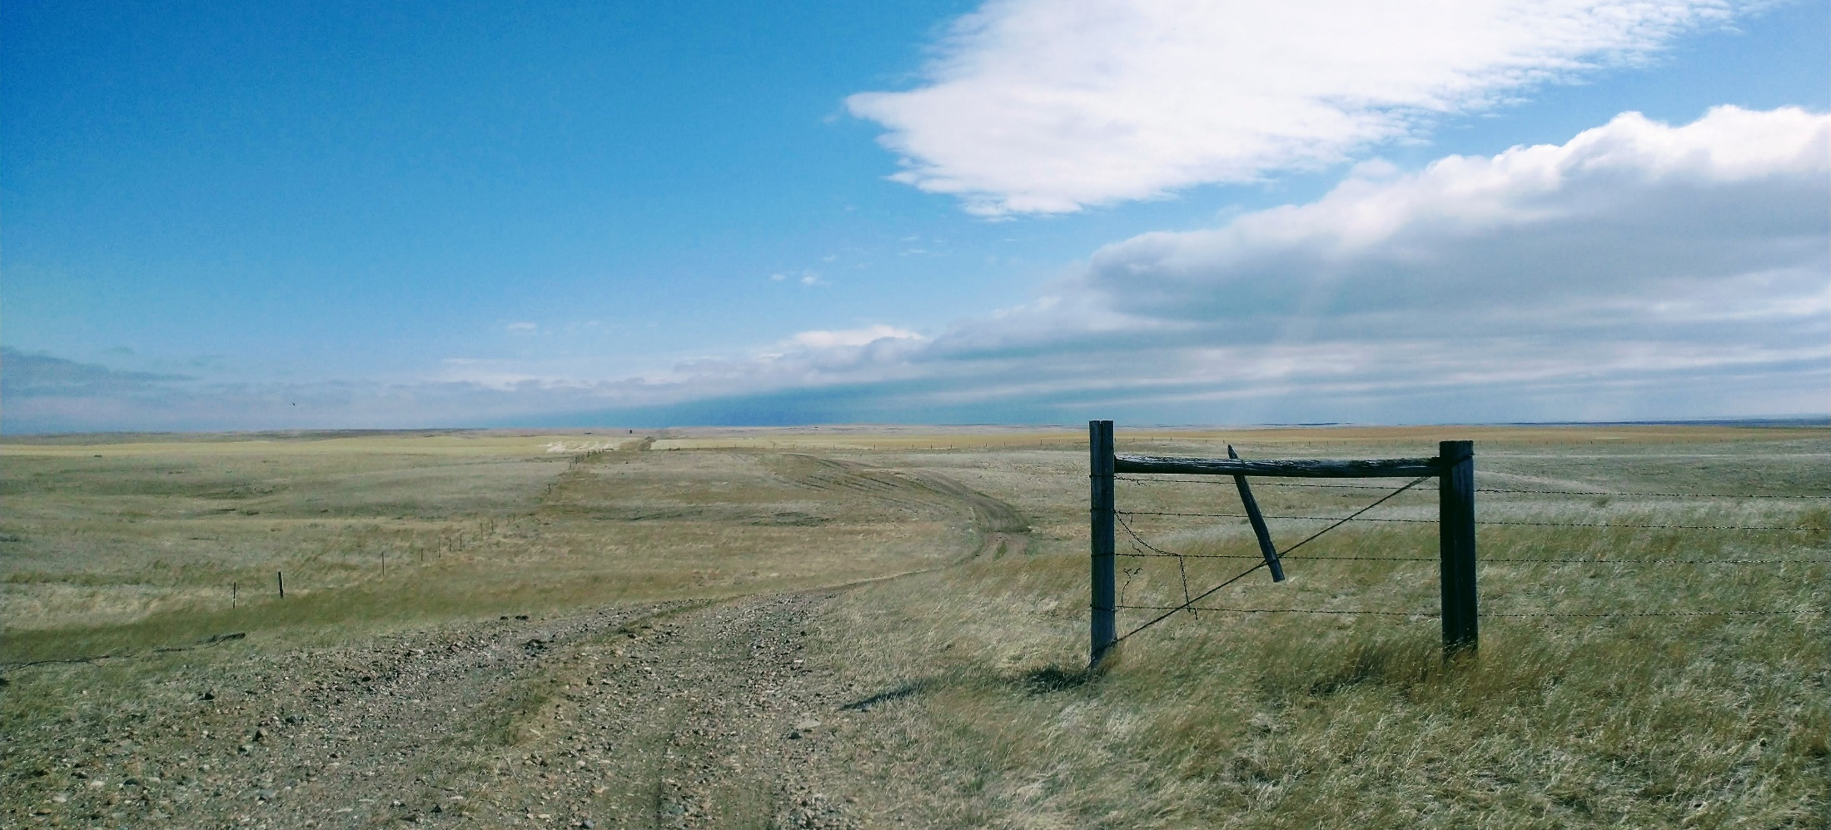
Where are the Workers?
May 2021
Barbara Wagner,
Chief Economist

Slide 2
Montana Unemployment Rate
MT: 3.8%
Source: LAUS & CES, MTDLI.
Notes:
Montana’s labor market is tight. Back to pre-pandemic levels.

Slide 3
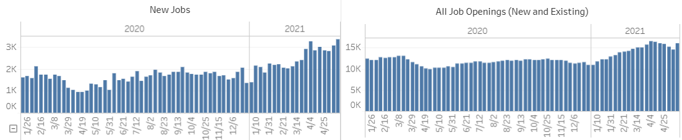
Other Measures of Tight Labor Markets
More job openings than before pandemic
Re-opening all at once is driving up new jobs
lmi.mt.gov/Home/Job-Tracking
Notes:
Job openings data also indicates that hiring has recovered. However, because there are many businesses reopening all at once, there is some amount of “pent-up” hiring this spring. Its unclear how much, but the economy has not fully recovered in terms of production, so at least some of this is a delay in hiring over the last year.

Slide 4
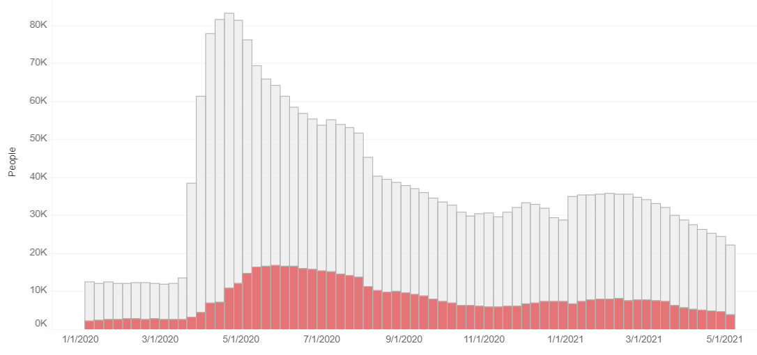
Number making UI Claims
Total Job Openings:
17,000
22,200 claimants
4,000 claimants working part time
Working Part Time
https://lmi.mt.gov/Home/Job-Tracking
Notes:
The number of UI claimants without a job is roughly equal to the number of job openings. This ratio of roughly 1:1 is still lower than prior to the recession, where there was often 2-3 jobs per claimant. However, we have about 22,200 folks currently making claims, and its natural to think of these as the first target for filling the job openings.

Slide 5
Wage Replacement of UI Benefits
Source: MTDLI based on available unemployment claim data. PUA claimants are excluded.
Notes:
The tight labor markets with high levels of people claiming unemployment has raised concerns about whether unemployment benefits are too generous. This chart shows the average amount of wages replaced by unemployment insurance. Last summer during the height of the pandemic, the additional $600 went above and beyond the level of prior wage loss. That isn’t the case in 2021, however. We are replacing about 85% of the prior wage amount right now. However…

Slide 6
How much of the previous wage is replaced by UI?
Source: MTDLI unemployment claims data. No benefit increase is Feb. 2020. $600 FPUC is May 2020. $300 FPUC is Feb 2021. Wage group based on base period wages.
Notes:
The 85% is an average of all claimants. When you break the payments down by income level, there are some low-income claimants who are currently receiving more than their prior wage amounts. This chart shows the wage replacement rate by prior wage level group. Claimants who earned less than $20,000 in the base period have benefit amounts higher than their prior weekly wage. That would include minimum wage workers who work 40 hours a week, or anyone working full time earning less than $9.60. The higher unemployment benefits have created some competition between businesses and the unemployment program. Worker shortages are typically felt most acutely at the low wage levels anyway, as higher wage jobs can bring people up from lower down on the career ladder, but low-wage employers have to compete against each other for these wages. I think there is reason to believe that the high levels of unemployment compensation is distorting the competition for workers at low wage levels.

Slide 7
Governor Gianforte’s
Return to Work Initiative
Ending pandemic unemployment programs June 26
  PUA – self-employed, parents without childcare, others
  PEUC – extended unemployment compensation
  FPUC – additional $300
  MEUC – rarely used, people with both self-employment and payroll income
$1,200 return to work bonus for those on unemployment who return to work for at least four weeks
UP NEXT: Getting the long-term unemployed back to work!
Notes:
That is why Governor Gianforte decided to end the pandemic unemployment programs on June 27, which everyone has likely heard about in the paper. There are several programs that will be ending June 27, including the programs for the self-employed and parents who are working reduced hours due to childcare concerns. I’m not going to dive into the wonky details on these programs, but the main gist is that after June 27, we will be back to our normal unemployment program that covers 28 weeks only without any additional benefits, with the maximum payment of roughly $500 per week. In addition, the governor is offering a $1,200 return to work bonus for workers transitioning off the unemployment insurance program. Claimants eligible for that benefit will be contacted by MTDLI.

Slide 8
How many workers affected?
Projected
June 26:
Regular:
7,400
Pandemic:
-10,650
Source: lmi.mt.gov/home/job-tracking. Assumes a conservative 3% decline per week from May 8 to June 26.
Notes:
We have been getting some questions about how many workers will be on the pandemic related programs on June 27 when they end, and this chart shows the claims by program, with a forecasted amount for May and June. If we assume a conservative decline of 3% per week for the next few weeks, we would have about 7,400 individuals still eligible for unemployment – that’s shown in blue. That is still a bit higher than we were prior to the pandemic, but not by a lot. But there are likely going to be about 10,650 claimants who will no longer be eligible. Certainly, both of these populations will be looking for work in the next few months.

Slide 9
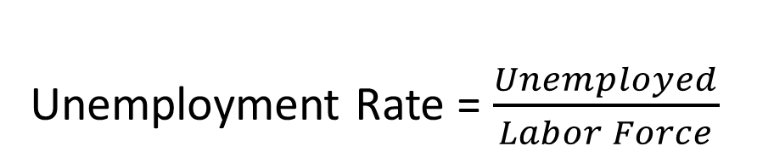
Calculating Unemployment
Unemployment Rate = $\frac{Unemployed}{Labor Force}$
Labor Force = employed + those looking for work (unemployed)
Notes:
The changes to the UI program are likely to increase job search efforts by those currently claiming unemployment, but in some ways, that is the easiest population to get back to work. And getting those workers back to employment is not going to suddenly result in worker surpluses. In fact, once employed, the unemployment rate will go down. The current rate is 3.8%, and if all 10,600 people currently claiming pandemic-related unemployment got a job, the unemployment rate would be much lower…like around 2%. So where are the missing people? Where did those workers go?

Slide 10
Montana Labor Market
Indexed to February
Source: LAUS & CES, MTDLI.
Notes:
The answer lies within the labor force numbers. There have been a lot of workers who have stopped working – not claiming unemployment, just not receiving any benefits – during this pandemic. This chart shows Montana’s employment and labor force numbers since Jan 2020, but shows them as a percentage of the Feb 2020 level. That means the pre-pandemic level is 100%, and allows us to easily compare where we are now to where we were. The big problem is the labor force line, shown in grey, which has slowly sunk down since about last June. We have lost over 10k people from our labor force in the last year, and that’s a big problem when Montana has been facing worker shortages for the last ten years.

Slide 11
Why has labor force declined?
10,000 workers dropped out of the labor force
  Existing problem worsened by COVID-19
  55,000 Montana parents with reduced work hours
  Accelerated retirements
  Risk of COVID exposure ~ 10,800 Montanans
    Low-wage, part-time older workers
Source: LAUS & CES, MTDLI. CPS for other reasons. See Watson, 2021 & Holom 2021 for more details at lmi.mt.gov/Publications/index
Notes:
So where have those people gone? Why did they drop out? A big part of the problem is childcare and school closures. Parents have really had a tough time juggling learning at home at the same time as managing distance learning this year. Even now when the schools are mostly back in person, the schedules often change with frequent closures and need to quarantine. Amy Watson will be talking about that more in the upcoming presentation. I also think we probably saw a lot of older Montanans take early retirements this year. The older population is at most risk from COVID-19, and the stock market has been great. We don’t have great data yet, but its reasonable to think that conditions would result in those close to retirement deciding to head off in their RV instead of return to work. And finally, we also know that there are a lot of Montanans who have health conditions or take care of those with health conditions where the lure of a low-wage job was not enough to risk their health. Nationally, there is a lot of data regarding workers choosing to not go back to work due to the risk of COVID, especially for workers who work face to face with customers.

Slide 12
How do we fix labor force attrition?
Widespread vaccinations to bring workers back in
Focus on allowing work-life balance
Remote work allows for hiring from rural areas, reservations, or out-of-state
Childcare and schools
Same things we did before…apprenticeship, retention pay, engaging with schools, non-monetary benefits
Notes:
How do we get those people back in? Well, vaccinations are certainly going to help. Even with only part of the population vaccinated, there is still a high risk of mutated strains of COVID that some workers may choose to avoid. Kids are also not vaccinated yet, with the Pfizer vaccine just recently allowed for kids 12 and older, but still nothing for younger kids. That still means that parents will need to have flexibility in scheduling when their kids have to quarantine. But there are options, and in some ways, the pandemic has actually expanded the options for Montana businesses. There are regions of Montana that still have high unemployment rates, such as on the reservations and in Northwest Montana, and remote work options would allow employers to better access those workers. I know many of those rural areas have been looking at remote work as an economic development initiative to get more wages into rural economies.

Slide 13
Total Wages Continued Growth
Still Down Jobs, but
Total Wages Expanded $613 million (4.9%)
Total Wages Paid in all Montana Payroll Jobs
Trend Line
Average Wage increased by 7.8% up to
$48,440 in 2020
Source: Total Wages from QCEW, MTDLI.
Notes:
One last thing to mention when hiring workers now in 2021, and that is that wages have increased dramatically in the last year, and employers should expect to be paying higher wages than prior to the pandemic. This chart shows the total amount of wages paid in all Montana jobs since 2015, and the red like shows the trend. You can see the blue line is above the trend for 2020, with strong wage growth (4.8%) despite the loss in the total number of jobs. The average wage increased by 7.8% over the year, now at $48,400.

Slide 14
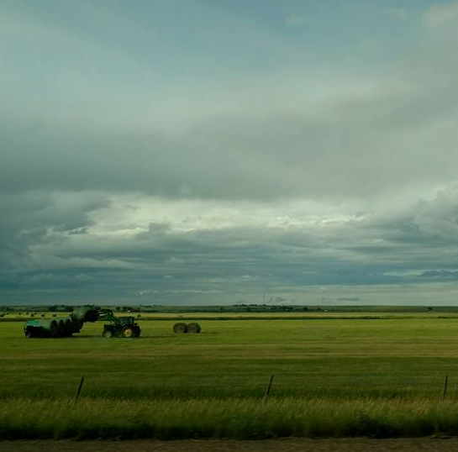
More Information at lmi.mt.gov
Barbara Wagner
Chief Economist
MT Dept. of Labor and Industry
bwagner@mt.gov

