Slide 1


Safety Protocol- Entities with Heavy Public Interaction
Date: July 29th, 2020
Hosted By: Kathleen O’Leary
Deputy Commissioner
Montana Department of Labor and Industry

Slide 2
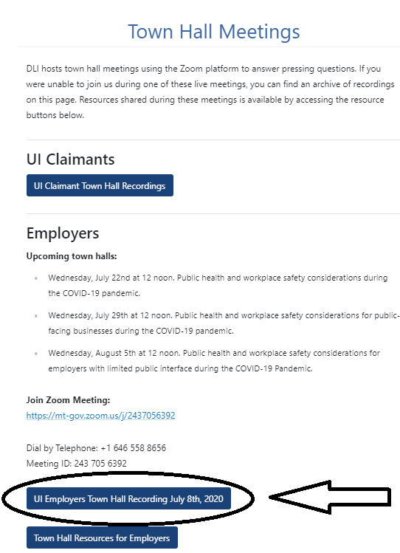
https://dli.mt.gov/town-halls

Slide 3
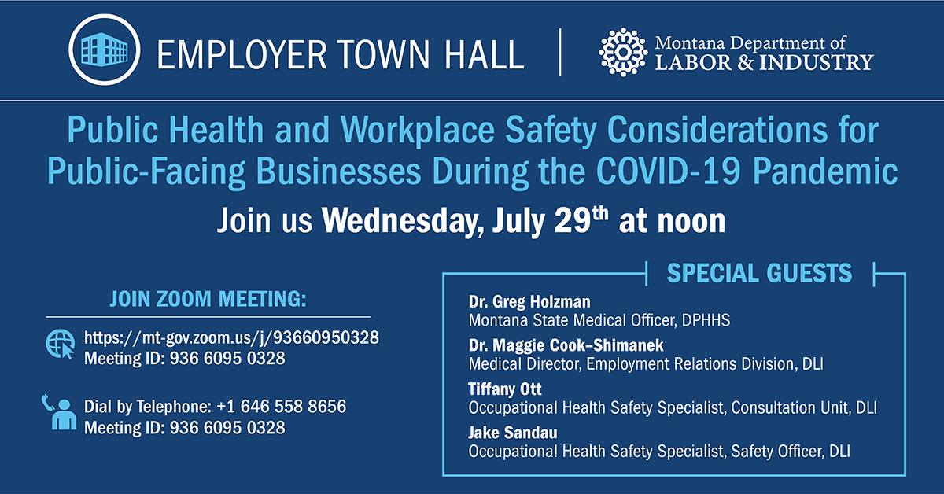

Slide 4
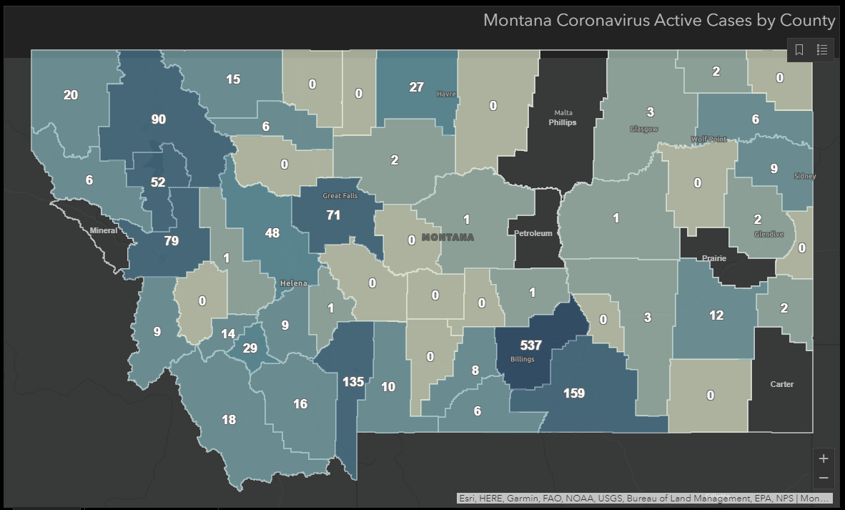
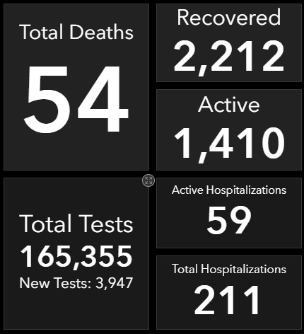
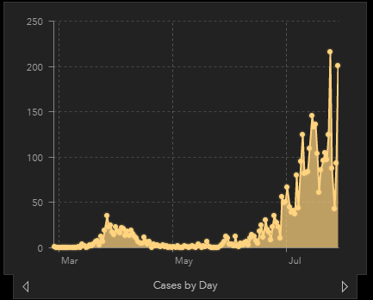
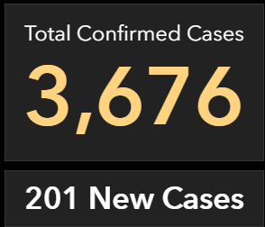
As of 10:00 AM 7/29/2020

Slide 5
Governor Steve Bullock Directives
Senior Living and Assisted Living Facilities https://dphhs.mt.gov/Portals/85/Documents/NewsLetters/NursingHomeVisitationDirective.pdf
Nursing Homes, Skilled Nursing Facilities, and Senior and Assisted living Facilities https://covid19.mt.gov/Portals/223/Documents/Nursing%20Home%20Visitation%20II%20Directive.pdf?ver=2020-07-13-143616-250
Providing For the Mandatory Use of Face Coverings in Certain Settings https://dphhs.mt.gov/Portals/85/Documents/NewsLetters/MaskDirective.pdf
Providing For the Mandatory Use of Face Coverings in Certain Settings https://dphhs.mt.gov/Portals/85/Documents/NewsLetters/MaskDirective.pdf
Occupational Safety and Health Administration (OSHA)
OSHA Guidance on Preparing Workplaces for COVID-19 https://www.osha.gov/Publications/OSHA3990.pdf
OSHA Control and Prevention https://www.osha.gov/SLTC/covid-19/controlprevention.html
Retail Workers and Employers in Critical and High Customer-Volume Environments https://www.osha.gov/SLTC/covid-19/controlprevention.html

Slide 6
Center for Disease Control and Prevention (CDC)-Health
Symptoms https://www.cdc.gov/coronavirus/2019-ncov/symptoms-testing/symptoms.html
How It Spreads https://www.cdc.gov/coronavirus/2019-ncov/prevent-getting-sick/how-covid-spreads.html
Quarantine If You Might Be Sick https://www.cdc.gov/coronavirus/2019-ncov/if-you-are-sick/quarantine.html?CDC_AA_ refVal=https%3A%2F%2Fwww.cdc.gov%2Fcoronavirus%2F2019-ncov%2Fif-you-are-sick%2Fquarantine-isolation.html
Caring for Someone https://www.cdc.gov/coronavirus/2019-ncov/if-you-are-sick/care-for-someone.html
Community-Related Exposures https://www.cdc.gov/coronavirus/2019-ncov/php/public-health-recommendations.html
Washing Cloth Face Coverings https://www.cdc.gov/coronavirus/2019-ncov/prevent-getting-sick/how-to-wash-cloth-face-coverings.html
Quarantine and Isolation https://www.cdc.gov/quarantine/air/reporting-deaths-illness/definitions-symptoms-reportable-illnesses.html

Slide 7
Center for Disease Control and Prevention (CDC)- Work
Guidance for Businesses and Employers https://www.cdc.gov/coronavirus/2019-ncov/community/guidance-business-response.html
Cleaning and Disinfection for Community Facilities https://www.cdc.gov/coronavirus/2019-ncov/community/organizations/cleaning-disinfection.html
Ending Home Isolation https://www.cdc.gov/coronavirus/2019-ncov/hcp/disposition-in-home-patients.html
Return-to-Work Criteria https://www.cdc.gov/coronavirus/2019-ncov/hcp/return-to-work.html
Critical Workers https://www.cdc.gov/coronavirus/2019-ncov/community/critical-workers/implementing-safety-practices.html
Considerations for Restaurants and Bars https://www.cdc.gov/coronavirus/2019-ncov/community/organizations/business-employers/bars-restaurants.html

Slide 8
US Equal Employment Opportunity Commission Guidance https://www.eeoc.gov/wysk/what-you-should-know-about-covid-19-and-ada-rehabilitation-act-and-other-eeo-laws
Disinfectants for Use Against SARS-CoV-2 (COVID-19) https://www.epa.gov/pesticide-registration/list-n-disinfectants-use-against-sars-cov-2-covid-19
Recommendations for Use of Cloth or Disposable Face Coverings (COVID-19) https://acoem.org/acoem/media/PDF-Library/COVID-19-ACOEM-Recommendations-Regarding-Use-of-Face-Coverings-in-the-Workplace-4-10-2020.pdf
FAQs: The ADA, Small Business and Face Mask Policies https://www.gpadacenter.org/faqs-ada-small-business-and-face-mask-policies
Job Accommodation Network (JAN) Accommodation and Compliance (COVID-19) https://askjan.org/topics/COVID-19.cfm

Slide 9

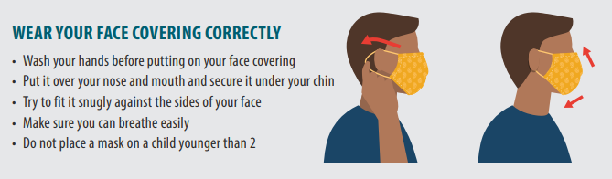
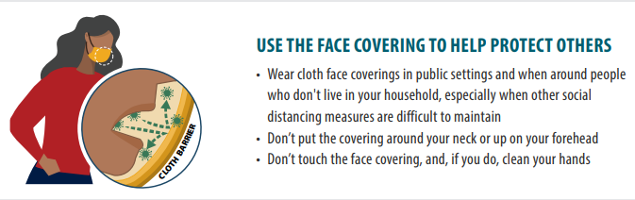
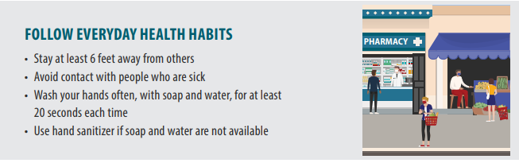
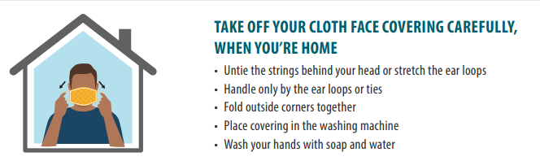
https://www.cdc.gov/coronavirus/2019-ncov/downloads/cloth-face-covering.pdf

Slide 10

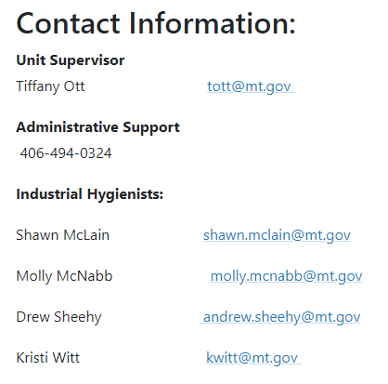
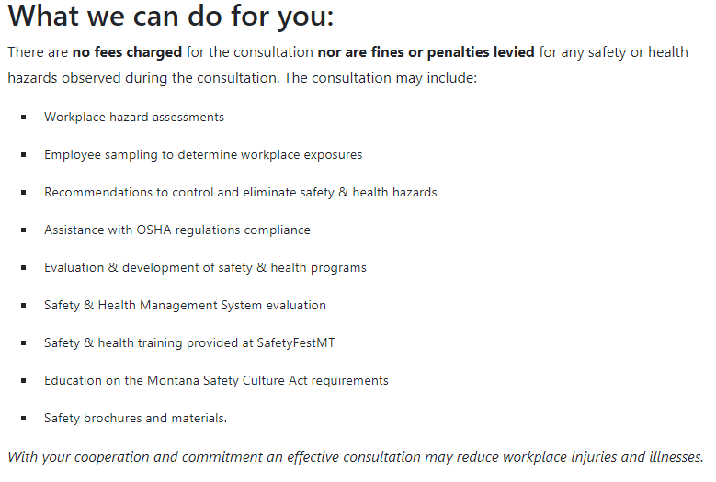
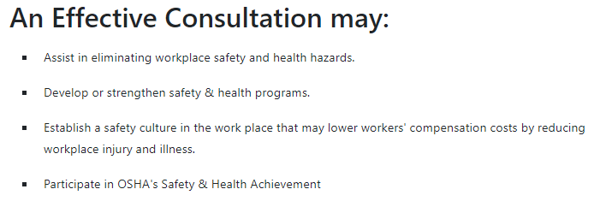
http://erd.dli.mt.gov/safety-health/onsite-consultation

Slide 11
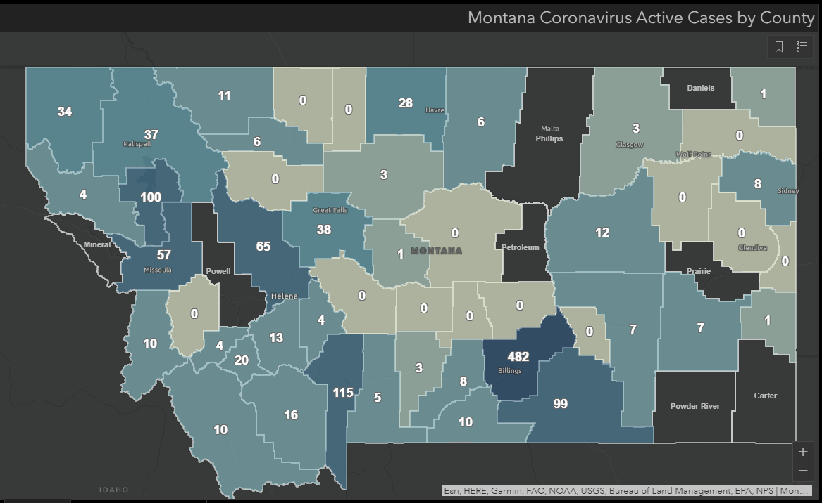
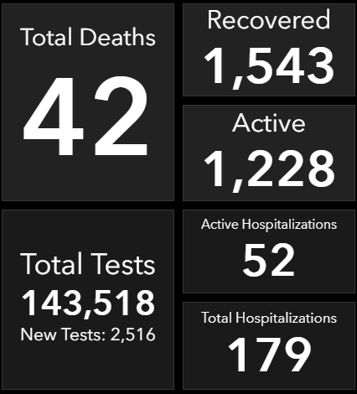
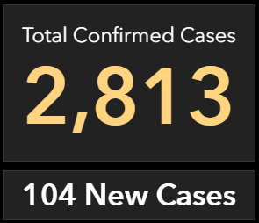
https://dphhs.mt.gov/publichealth/cdepi/diseases/coronavirusmt/demographics
As of 10:20 AM 7/22/2020

