Slide 1

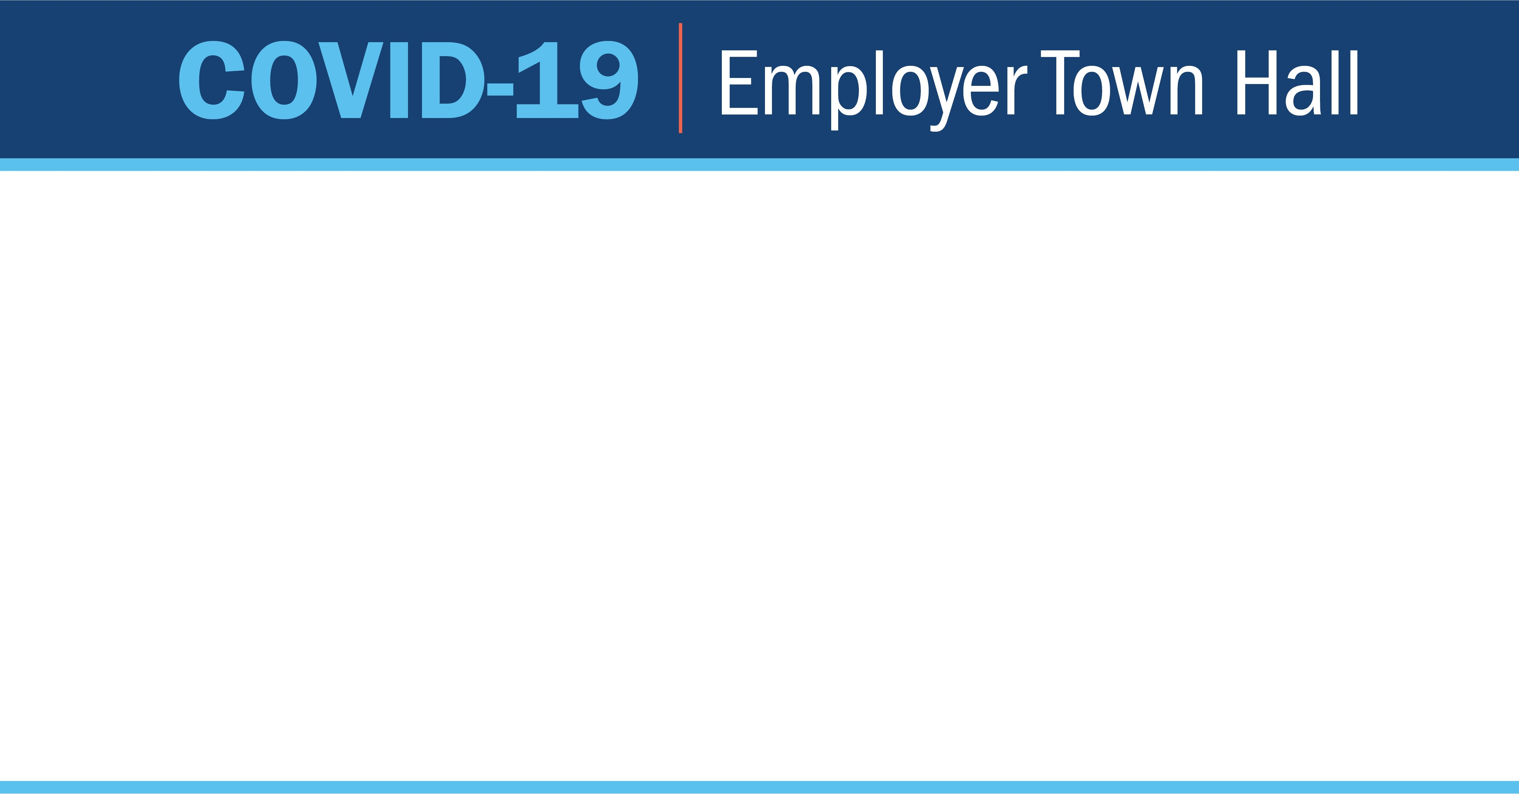
What Does “Diverse Workforce” Mean in Montana
Date: July 8th, 2020
Topic: Diversity in Recruiting and Retention
Hosted By: Kathleen O’Leary
Deputy Commissioner
Montana Department of Labor and Industry

Slide 2
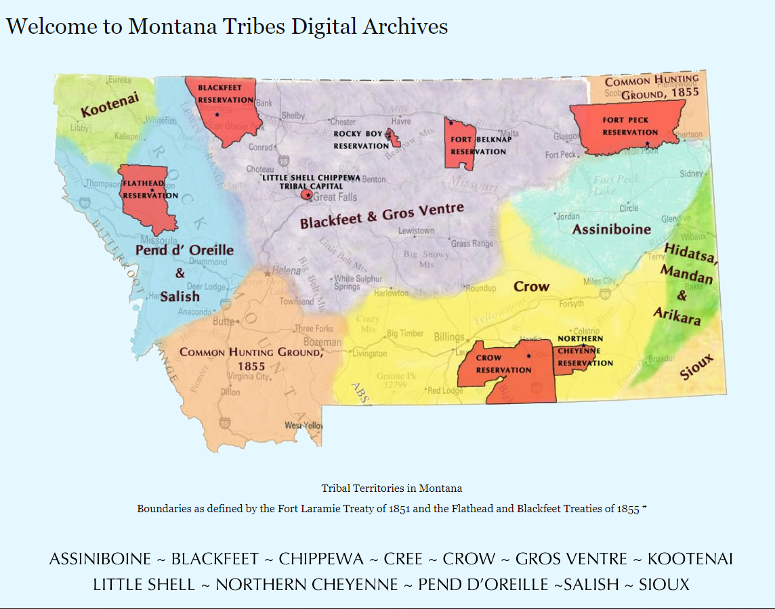
Montana Reservation Map and Excellent Resources:
http://montanatribes.org/

Slide 3

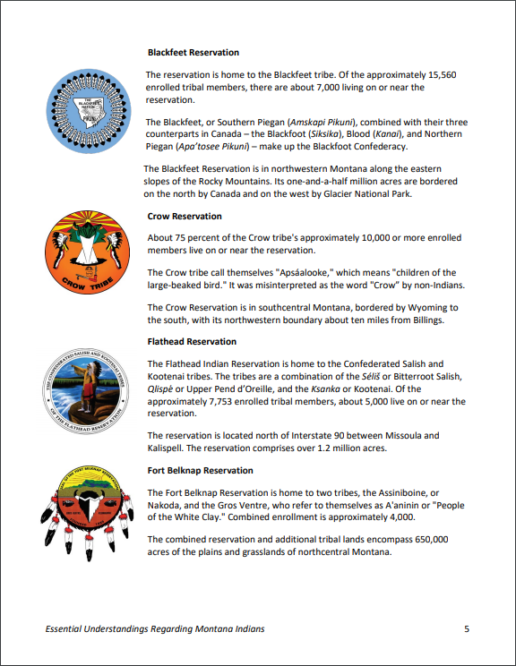
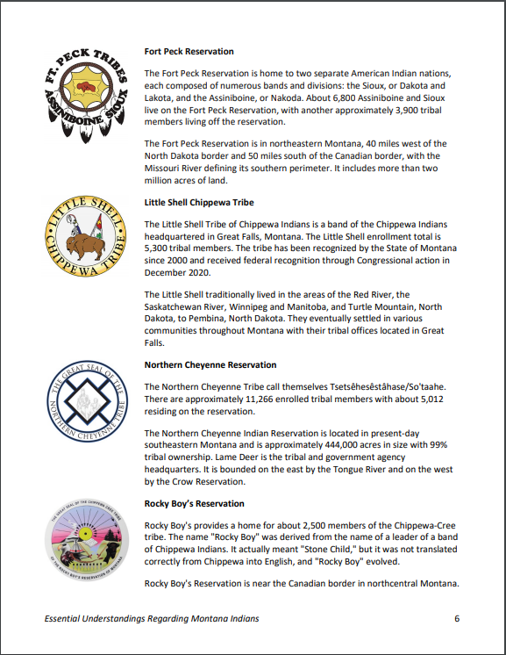
Essential Understandings:
https://opi.mt.gov/Portals/182/Page%20Files/Indian%20Education/Indian%20Education%20101/essentialunderstandings.pdf

Slide 4
1. VRBS Business Services:
https://dphhs.mt.gov/detd/vocrehab/BusinessServices
2. Office of Disability Employment Policy:
https://www.dol.gov/odep/
3. Job Accommodation Network (JAN):
https://www.dol.gov/odep/resources/jan.htm
4. Windmills: Changing the Perception of Disability:
http://www.miltwright.com/products/windmills.htm
5. Campaign for Disability Employment:
https://www.dol.gov/odep/topics/CampaignForDisabilityEmployment.htm
6. Montana Department of Public Health and Human Services, Telework Assistance Grants:
https://commerce.mt.gov/Montana-Coronavirus-Relief/Health-and-Human-Services
To assist Montanans with disabilities access telework equipment. This assistance will help ensure people with disabilities have the equipment needed to adapt to the change in working environment due to COVID-19.
Current funding available is $650,000. If you are interested in applying, please email vrinfo@mt.gov with your name and contact information, with Telework Assistance Grants as the subject of the email. 1.888.333.0461 | DPHHS.MT.GOV

Slide 5

Marieke Beck
Bureau Chief
Human Rights Bureau
(406) 444.4344
The Human Rights Bureau’s website:
www.montanadiscrimination.com’
Rocky Mountain ADA Center:
https://www.rockymountainada.org/
Job Accommodation Network (JAN):
https://askjan.org/
JAN Reasonable Accommodations for Employees (Click on Part III):
https://askjan.org/publications/employers/employers-guide.cfm
U.S. Equal Employment Opportunity Commission (EEOC)
Small Business Resource Center:
https://www.eeoc.gov/employers/smallbusiness/index.cfm
Policy Guidance on Current Issues of Sexual Harassment:
https://www.eeoc.gov/policy/docs/currentissues.html
Promising Practices for Preventing Harassment:
https://www.eeoc.gov/eeoc/publications/promising-practices.cfm
Q/A:
https://www.eeoc.gov/facts/accommodation.html

Slide 6
DLI COVID RESOURCES
DLI Main Webpage: http://dli.mt.gov/
COVID Main Webpage: http://dli.mt.gov/employer-covid-19
COVID Employer FAQ: http://dli.mt.gov/employer-covid-19/employer-resource-covid-19
Town Hall Info & Recordings: http://dli.mt.gov/town-halls

