Slide 1
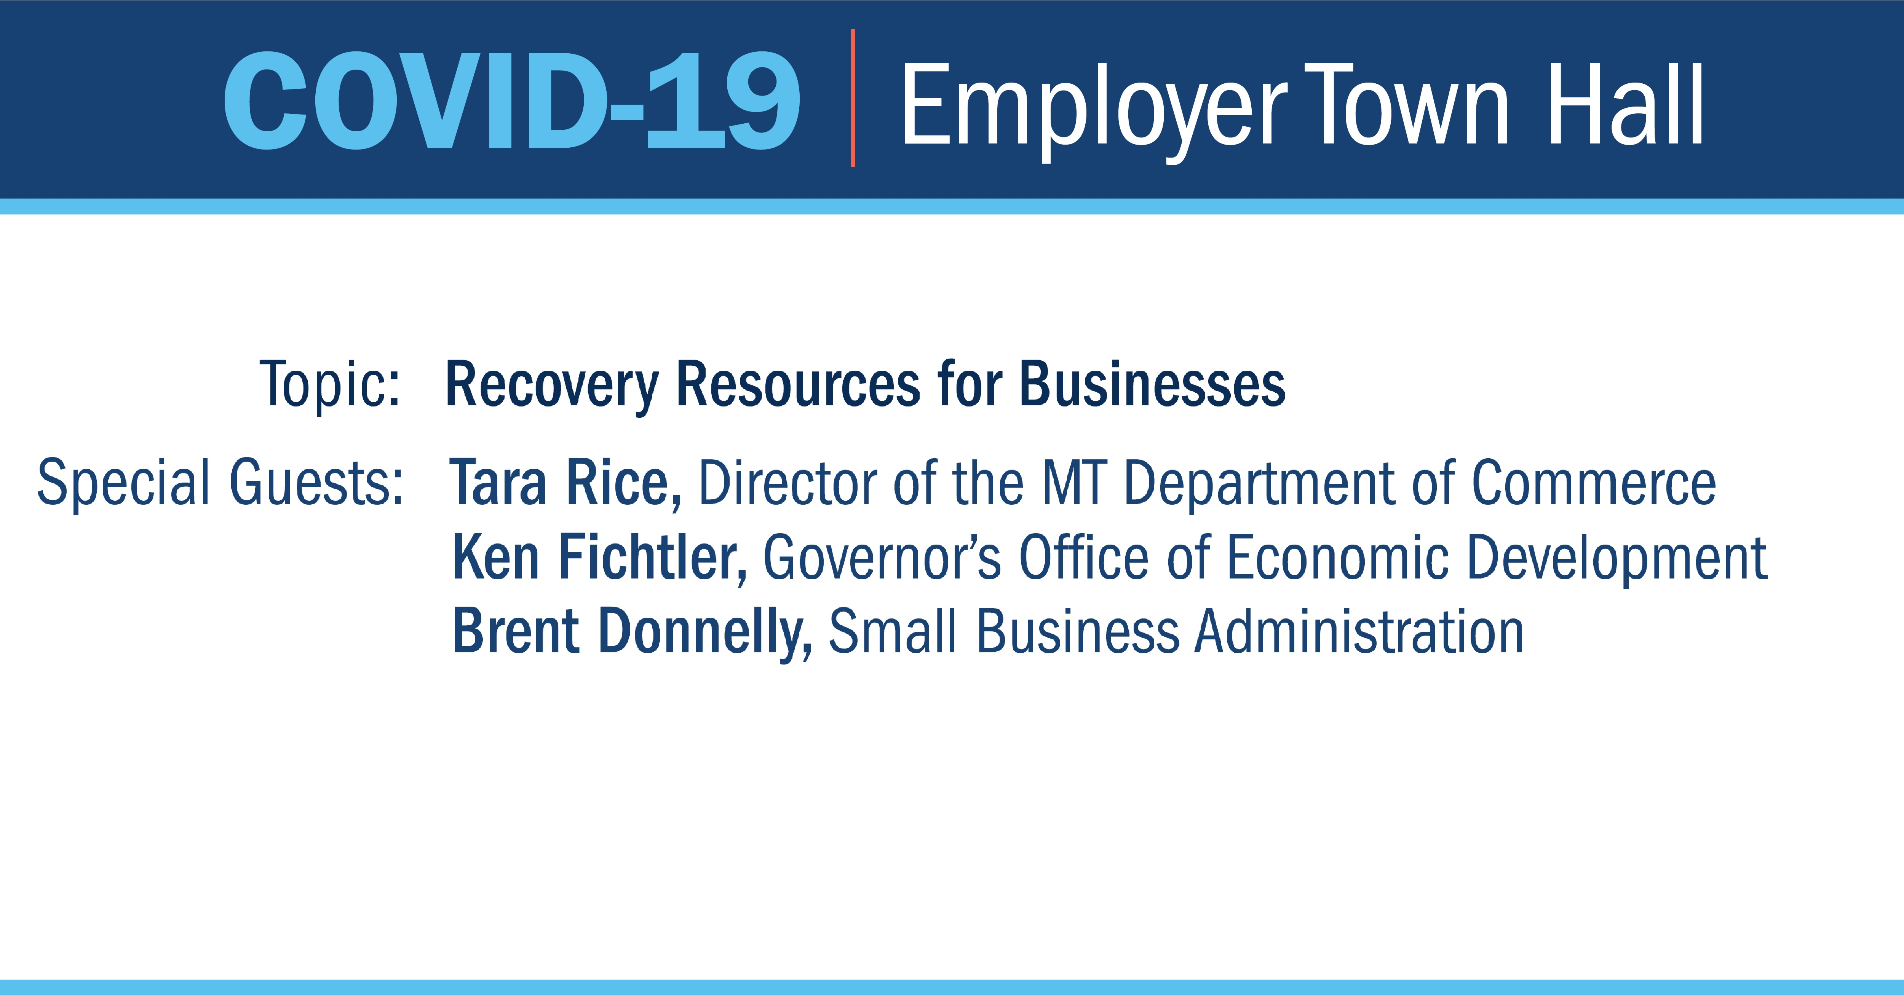

Slide 2
PUA Benefits
14. PUA Benefits Link
(Self-Employed, Independent Contractors & Others Web Page)
http://dli.mt.gov/self-employed-contractors
15. File for PUA Benefits
https://mtpua.mt.gov/
16. MTDLI Return to Work
http://www.dli.mt.gov/return-to-work
17. Governor's Directive
https://covid19.mt.gov/
18. MT Coronavirus Relief – Emergency Grants Available
https://commerce.mt.gov/Coronavirus-Relief

Slide 3


MT Coronavirus Relief – Emergency Grants Available
COVIDRELIEF.MT.GOV
Montana Business Stabilization Grant program
Montana Innovation Grant program
Montana Food and Agriculture Adaptability Program
Emergency Housing Assistance Program
Public Health Grants
Stay Connected Grants
Food Bank and Food Pantry Assistance
Social Services Nonprofit Grants
Telework Assistance Grants
Child Care Grants
BESTBEGINNINGS.MT.GOV
Governor's Directive
https://covid19.mt.gov/
The Montana Business Stabilization Grant For Small Businesses to support:
Payroll, rent, accounts payable, debt service and expenses related to shifts in operations in order to retain existing businesses, retain current employees or retain business viability for future re-employment.
To prepare for the application:
Businesses and non-profits should have their
  tax ID,
  proof of business registration,
  a brief description of how the grant will be spent,
  brief description of how COVID-19
  has impacted operations.

Slide 4

Interim Final Rule on Loan Forgiveness - https://home.treasury.gov/system/files/136/PPP-IFR-Loan-Forgiveness.pdf [home.treasury.gov]
This document includes information on, but not limited to: (be sure to check the full document for all details)
  Loan Forgiveness Process
  Payroll Costs Eligible for Loan Forgiveness
  Nonpayroll Costs Eligible for Loan Forgiveness
  Reductions to Loan Forgiveness Amount
  Documentation Requirements
Interim Final Rule on SBA Loan Review Procedures and Related Borrower and Lender Responsibilities - https://home.treasury.gov/system/files/136/PPP-IFR-SBA-Loan-Review-Procedures-and-Related-Borrower-and-Lender-Responsibilities.pdf [home.treasury.gov]
This document includes information on, but not limited to: (be sure to check the full document for all details)
  SBA Reviews of Individual Loans (what will be reviewed and when)
  The Loan Forgiveness Process for Lenders (what should be reviewed and timeline)
  Lender Fees (clawback information)
PPP Loan Forgiveness Application - https://home.treasury.gov/system/files/136/3245-0407-SBA-Form-3508-PPP-Forgiveness-Application.pdf [home.treasury.gov]
  SBA Policy Guidelines
    https://home.treasury.gov/policy-issues/cares/assistance-for-small-businesses [home.treasury.gov]
Paycheck Protection Program:
https://www.sba.gov/funding-programs/loans/coronavirus-relief-options/paycheck-protection-program [sba.gov]

Slide 5
For SIDES E-Response participants, to amend your response:
Log into uieservices.mt.gov
Navigate to the SIDES Request tab
Select View/Amend to launch the SIDES E-Response portal
On the UI SIDES E-Response Switchboard, select Separation Information
For the claimant you wish to amend, select Create Amendment
  On the Amended Response page please provide as much detail as possible: employee’s refusal of work, including: the claimant’s name, the date(s) they refused work, what type of work was offered, how was the work offered and by whom, and what was the reason given for not accepting the work.
Or
Submit by a secure web message via uieservices.mt.gov or by email to uieservices@mt.gov.
  Include a much detail as possible about the claimant’s refusal and include the Claimant ID of the refusing employee, as well as the employer’s name and contact person. Do not include personal information such as the employee’s social security number.
If you have questions about the notification
of refusal process, contact our eServices
at (406) 444-3834, select option 2.

Slide 6
Occupational Safety and Health Administration (OSHA)
1. Safety and Health Topics – COVID-19 (includes information on relevant OSHA standards) https://www.osha.gov/SLTC/covid-19/standards.html
2. Guidance on Preparing Workplaces for COVID-19. https://www.osha.gov/Publications/OSHA3990.pdf
6. OSHA Act -
Right to Refuse Dangerous Work
https://www.osha.gov/right-to-refuse.html
7. OSHA Industry Specific guidance on COVID control and prevention
https://www.osha.gov/SLTC/covid-19/controlprevention.html
American College of Occupational & Envir Medicine
3. COVID-19 Resource Center (includes links to webinars, Q&A, and other resources) https://acoem.org/COVID-19-Resource-Center
8. How to Help Your Company Develop a Complete COVID-19 Return-to-Work Plan
http://www.allthingsadmin.com/covid-19-return-to-work-plan/
9. Risk-informed decision-making guidelines for workplaces and businesses during the COVID-19 pandemic
https://www.canada.ca/en/public-health/services/diseases/2019-novel-coronavirus-infection/guidance-documents/risk-informed-decision-making-workplaces-businesses-covid-19-pandemic.html
Centers for Disease Control and Prevention (CDC)
4.. Interim Guidance for Businesses and Employers to Plan and Respond to Coronavirus Disease 2019 (COVID-19). (includes guidance on maintaining a healthy work environment, reducing transmission among employees, etc.) https://www.cdc.gov/coronavirus/2019-ncov/community/guidance-business-response.html​
5. Request a ​ Free Safety Consultation ​
MTDLI Employment Relations Division ​
http://erd.dli.mt.gov/safety-health/onsite-consultation ​

Slide 7
Pandemic Unemployment Assistance (PUA) Expanded UI benefits for individuals who are not traditionally covered, including the self-employed, gig-workers, independent contractors, and workers with irregular work history, etc.
Federal Pandemic Unemployment Compensation (FPUC)
The additional $600 weekly unemployment compensation benefit.
Pandemic Emergency Unemployment Compensation (PEUC)
Additional 13 weeks of benefits for workers who exhaust the typical duration of UI compensation available
14. PUA Benefits Link
(Self-Employed, Independent Contractors & Others Web Page)
http://dli.mt.gov/self-employed-contractors

Slide 8

Who Is Eligible for PUA? You may be eligible for PUA unemployment benefits if you are not covered under regular unemployment and you are otherwise able and available to work but due to specified COVID-19 related reasons, are currently unable or unavailable to work.
You are self-employed, an independent contractor, or not otherwise eligible for regular unemployment benefits.
You had a previous unemployment overpayment or something similar.
You have been diagnosed with COVID-19 or have symptoms of it and are trying to get diagnosed.
A member of your household has been diagnosed with COVID-19.
You are providing care for someone in your household diagnosed with COVID-19.
You are providing care for a child or other household member who can't go to school or a care facility because it's closed due to COVID-19.
You are quarantined or have been advised by a healthcare provider to self-quarantine.
You were scheduled to start a job and no longer have the job due to COVID-19, the offer was rescinded, or you can’t reach the job.
You have become the primary earner for a household because the head of household died as a direct result of COVID-19.
You had to quit your job as a direct result of COVID-19.
Your place of employment is closed as a direct result of COVID-19.
You meet other criteria set
forth by the Secretary of Labor.

