Slide 1
Notes:
ESGR is the Department of Defense Program for information, education and mediation for Guard and Reserve members better known as reserve component members or service members, and their employers concerning their USERRA rights and responsibilities.
ESGR serves all Seven Reserve Components:
Army National Guard,
Army Reserve,
Marine Corps Reserve,
Navy Reserve,
Air National Guard,
Air Force Reserve,
Coast Guard Reserve.
ESGR is here for YOU as a current or future employer of our Montana Guard and Reserve members.

Slide 2
INTRODUCTION
Introduction of ESGR Volunteer
Name: __________________
When I am not an ESGR Volunteer I am a:________________
I am here today to: ______________
Hand out USERRA Flip Book
Uniformed Services Employment and Reemployment Rights Act (USERRA)
Some slides show USERRA Book page #’s
Notes:
Your Name
Your “regular job when not an ESGR Volunteer”
I am here to help you understand more about Employer Support of the Guard and Reserve (ESGR), the Uniformed Services Employment Reemployment rights Act (USERRA) and help you understand the resources ESGR Offers you when you hire a member of the Reserve component
Hand out USERRA Booklets page references shown on slides for easier referencing

Slide 3
What is ESGR?
Employer Support of the Guard and Reserve
Department of Defense (DoD) program since 1972
Provides information, education and mediation for Service members and their civilian employers regarding federal laws protecting Service members when they perform military service.
ESGR consists of a network of thousands of volunteers in the United States, Guam, Puerto Rico, the Virgin Islands and the District of Columbia.
Notes:
ESGR is the DoD program for information, education and mediation for Reserve component members or Service members, and their employers concerning their USERRA rights and responsibilities.
ESGR serves all Seven Reserve Components: Army National Guard, Army Reserve, Marine Corps Reserve, Navy Reserve, Air National Guard, Air Force Reserve, and Coast Guard Reserve. ESGR is here for Service members and their civilian employers.
Employer Support of the Guard and Reserve is a Department of Defense (DoD) program within the Office of the Assistant Secretary of Defense for Reserve Affairs, and reports to the Office of the Secretary of Defense.
Established in 1972
It is the lead DoD organization for this mission under DoD Directive 1250.1
The Reserve Component members comprise approximately 50% of our total force.
ESGR consists of a network of thousands of volunteers thought the United States, Guam, Puerto Rico, the Virgin Islands and the District of Columbia

Slide 4
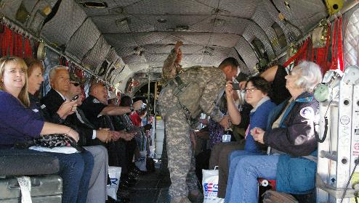
ESGR VISION
Develop and promote a culture in which all American employers support and value the military service of their civilian employees.
Helicopter flight or
“Boss lift” for employers aboard a Chinook Helicopter
Notes:
How do we promote positive relationships?
ESGR does this by:
Advocating mutually beneficial initiatives;
Recognizing outstanding employer support;
Increasing awareness of applicable laws and policies;
Resolving potential conflicts between employers and their Service members;
Acting as the employers’ principal advocate within DoD.
-Outreach at events such as talking to employers at job fairs , ABC Clinics, employer events
-Educational military flights for current and future bosses of our service members in cities across Montana

Slide 5
UNDERSTANDING
ESGR can help you see how and why hiring a military employee will enhance your business.
ESGR can help you forge a stronger bond with your military employees through a greater understanding of their military service.

Slide 6
ESGR MISSION
EDUCATE AND ADVOCATE

Slide 7
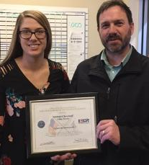
EDUCATE EMPLOYERS
Informs employers about their rights/responsibilities under the federal USERRA law.
Encourages employers to develop HR policies that go above and beyond the law in support of the military.
Educates employers with ESGR events.
Recognizes employers who meet or exceed the law
with My Boss the Patriot awards.
My Boss the Patriot Award Lithia in Billings Michael Cleveland
with MT ESGR Volunteer Jenn Phalen
Notes:
Inform:employers about their rights/responsibilities under USERRA
Encourage HR Policies such as differential pay when service member deployed- pay the difference between civilian pay and military pay while deployed.
Support service member during time away with emails, care packages, contact with family, help for family during longer deployments
Educate- Efforts include conversations, seminars, events, and awards to accomplish the mission of gaining and maintaining employer support and recognizing WITH AWARDS those employers who go above and beyond.
Boss lifts or helicopter flights and C130 flights around Montana. FY 18 Lewistown, Bozeman, Malta,, Great Falls
Breakfast with the Boss events at a local armory
Viewing of Bradley Fighting Vehicles and Abram Tank training at Limestone Hills outside Townsend.
AWARDS: My Boss the Patriot Award nomination by service member to supervisor
Photo: Bozeman Health Security Manager receives a Patriot Award from his guard member. Karl Mahn Bozeman ESGR left presented the award.

Slide 8
WHAT DOES
USERRA
STAND FOR?

Slide 9
USERRA
U.S.
Employers Are Really Really Awesome!

Slide 10
USERRA
Uniformed Services Employment and Reemployment
Rights Act
Notes:
What is USERRA?
USERRA is a federal statute that protects service members’ and veterans’ civilian employment rights. Among other things, under certain conditions, USERRA requires employers to put individuals back to work in their civilian jobs after military service. USERRA also protects service members from discrimination in the workplace based on their military service or affiliation.
To understand the basic law –service members must be treated exactly like similar employees who are not in the military and never left for service time. In the law, congress’ intent was to ensure service members were not penalized in the civilian employment because of their service.

Slide 11
USERRA Primary purpose:
The Federal Law that protects the civilian employment rights of those who also serve in the uniformed service.
USERRA affects employment, reemployment, benefits, and retention for uniformed Service members.
Notes:
(1)Encourage non-career service in the uniformed services by eliminating or minimizing the disadvantages to civilian careers and employment which can result from such service;
(2)Minimize the disruption to the lives of persons performing service in the uniformed services as well as to their employers, their fellow employees, and their communities, by providing for the prompt reemployment of such persons upon their completion of such service; and
(3) Prohibit discrimination against persons because of their service in the uniformed services.

Slide 12
USERRA: WHO IS COVERED?
Applies to
Full-time or part-time employees
Applicants for employment
Guard & Reserve and Active military
1 employee or 1000 employees, USERRA covers service members.
USERRA Book Page 2
Notes:
USERRA covers those returning from a drill weekend, training, active duty or deployment.
SEE USERRA FLIP BOOKS PROVIDED FOR SPECIFIC DETAILS.
USERRA LAW has implications for the service member when they apply for a job, after they leave a job, and as long as they are employed.
All employers are covered, even if you only employ one employee and they are in the guard or reserve. Both full-time and part time employees are covered.
If you are in the Guard and Reserve and are a partner, owner or an independent contractor USERRA does not apply.

Slide 13
USERRA COVERAGE:
Title 10 VS Title 32
STATUS of Service members
Title 10: National service in missions commanded and funded by the federal government (president is boss)
Title 32: Service under the command of the state’s governor i.e.- major natural disasters- wild fires (governor is boss)
Title 32 – Section 502(f): National Guard are allowed to be called up for federal service, while remaining under the control of the governor
Notes:
Serving in the Guard and Reserve means they have two bosses; the governor and the president.
TITLE 10: Federal authority over Service members falls under Title 10 of the U.S. Code. These laws apply to active duty, Reservists, and Guard members who are ordered to federal-level active duty for federal-level missions. Funding comes from the federal government. The president is the boss.
TITLE 32: Federal authority over National Guard members falls under Title 32 of the U.S. Code. This is considered federal active duty for specific state missions and full-time Guard positions. This type of state-level activation is guided by state laws and policies but it is funded by the federal government after approval from the president. This typically happens with large-scale, state-related missions; major natural disasters for example. The governor is the boss even though the state mission is sanctioned and funded by the federal government.

Slide 14
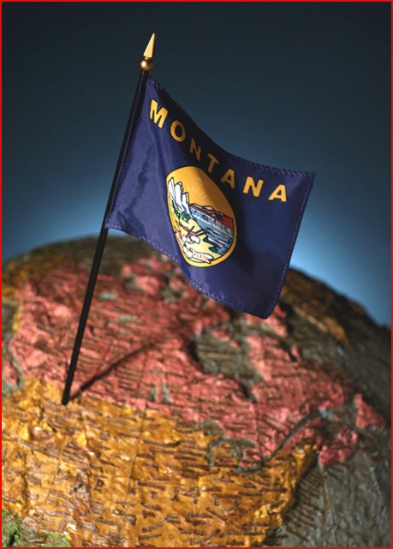
What about State Active Duty?
Montana Military Service Employment Rights - Part 10 of Montana Code Annotated
Similar rights as USERRA while supporting Governor’s call up to support state emergencies (fires, floods, blizzards, …)
Notes:
State Active Duty- Montana Military Service Employment Rights - Part 10 of Montana Code Annotated
Similar rights as USERRA while supporting Governor’s call up to support state emergencies (fires, floods, blizzards, …)
TITLE 32 under the Governor’s orders
Title 10 Under the President’s Orders
.

Slide 15
ESGR ADVOCATES for YOU
ESGR is an employer advocate
If it is undue hardship on your business for a Service member to attend a tech school or deployment contact ESGR. We may be able to help.
Examples:
Miles City Police Department- 4 of 8 police on staff were set to deploy; ESGR asked for help; in the end 2 were deployed.
ProLube- Weekly orders for Guard member changed to monthly orders to accommodate civilian job scheduling.
Notes:
ESGR advocates for the employer
If there is undue hardship on the employer ESGR can talk to the service member or the unit commander to help with the situation.
If you have a service member who volunteers all the time for duty; if having the service member out for 5 months will be a hardship give ESGR a call.
Miles City- 4 policemen were to be deployed.
Miles City Mayor said the deployment of so many was an undue hardship on the town with 4 of 8 police set to deploy.
They called ESGR who helped with the problem.
Miles City sent a letter sent to the Adjutant General of Montana who signed an order to only take 2 of the 4.
Two other guardsmen were deployed in their place.
Pro Lube- Service member was on weekly orders. Pro Lube did not know week to week if their manager was going to be at work. They called ESGR to see what they could do. ESGR called the unit commander to talk to them and said, “this employer needs help, put him on monthly orders or send him back to his civilian job.” They worked out a compromise.

Slide 16
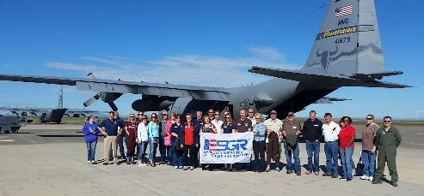
Keys to Success
Employers understanding their USERRA responsibilities and supporting their civilian employee’s service is key to retention in the Guard and Reserve.
The BNSF Military Scheduler for the USA was a guest on a C130 Boss lift. She flew in from Texas at her own expense to support 219th Red Horse members in Great Falls who work for BNSF.
Notes:
If you understand USERRA and know who to call for more information it makes your job easier as an employer.
BNSF Military Scheduler for the USA traveled to Great Falls for a C130 flight at the request of her 2 Montana Air National Guard members.
She was thrilled to be attend at her own expense to support her guard members.

Slide 17
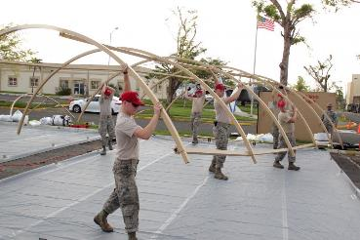
LEAVE OF ABSENCE
Furlough or
Leave of Absence
Employee away from work for military service deemed to be on leave.
Entitled to non-seniority
benefits like others on leave of other kinds.
219th RED HORSE erecting shelters

Slide 18
Service member obligations
USERRA Timelines
1-30 Days of Service
Report back to work on the next scheduled work day after safe travel home and eight hours of rest
31-180 Days of Service
Submit an application for reemployment within 14 days after release from period of service
181+ Days of Service
Submit an application for reemployment within 90 days after release from period of service
Provide advance notice to employer of military service -verbal or in writing.
Leave a civilian job for military service obligations.
If on extended active duty, serve honorably or under honorable conditions.
Serve for no more than five cumulative years away from the workplace, unless USERRA exemptions apply.
Notify employer of intent to return to work within USERRA guidelines.
18
Notes:
To be eligible for rights under USERRA, you must be employed by an employer, you must have left your employer because of military service, and you must meet all of the following requirements:
Provide prior notice to employer. You must provide prior notice to your employer that you will be performing military service. Notice may be verbal or in writing, but written notice is highly encouraged.
Serve under honorable conditions. Your period of military service performed must be honorable or under honorable conditions. Dishonorable, bad conduct, other than honorable discharges, dismissal, and dropped from the rolls forfeit USERRA protection.
Return to work in a timely manner. After performing your military service, you must formally apply to return to work in accordance with these USERRA time guidelines. Don’t mess with these timelines. If you miss them, your employer can consider you AWOL and use standard company policies to terminate employees who are absent without notice.
To maintain reemployment rights under USERRA, you must report back to work, or apply for reemployment, in accordance with the following time schedule:
1-30 Days of Service
Must report back to work on the next scheduled work day after safe travel home and eight hours of rest.
31-180 Days of Service
Must submit an application for reemployment within 14 days after release from period of service.
181+ Days or More of Service
Must submit an application for reemployment within 90 days after release from period of service.
--You are entitled to use any portion of the time to apply, up to the maximum time allowed, but you should coordinate your date of return with your employer.
--Though not required, you should submit your application for reemployment in writing. A sample application is available on our website at www.ESGR.mil.
--If eligible, Service member employees should be promptly reemployed. “Prompt reemployment” means as soon as practicable under the circumstances of each case; usually, within two weeks of the employee's application for reemployment.

Slide 19
TOP USERRA ISSUES
Military Obligation Discrimination
Reinstatement
Promotion/Pay Rate
Vacation/Work Schedule
Termination
Notes:
The basic rule is that Service member must be treated just like their peers who are serving in the military. Employees can be terminated, salaries reduced, schedules changed etc. only if non-military employees were treated the same way.
- Discrimination may include any treatment that occurs because you are in the military. Indicators are a pattern of conversations, missed promotions, or assignments made specifically to those in the military.
- Reinstatement – getting placed back in the same or comparable position upon return from military service called the ESCALATOR PRINCIPLE. Step off the escalator and step back on at the level of seniority they would have if they had never left or service.
- Promotion –members cannot be denied promotion due to military service, absences; members should be afforded the same promotion opportunities they would have received had they been serving continuously
- Vacation – various issues can arise here, including being required to use vacation days for military service, questions about accrual of vacation time. Service member cannot be required to use vacation for military time served.
- Initial hiring discrimination – denying initial employment because of military service

Slide 20
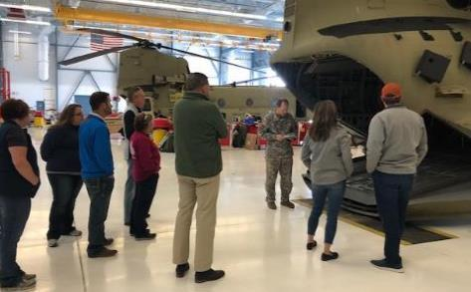
FREQUENTLY ASKED QUESTIONS
Q: Does USERRA protect a Service member for both involuntary and voluntary mobilization activation?
A: Yes. There is no
difference
between voluntary and
involuntary service
– also applies to
weekend drills.
USERRA Book Page 4
Boss lift MT Army National Guard hanger tour Helena, MT
Notes:
There is no difference between voluntary and involuntary service.
See USERRA Book page 4 for full list of coverage-

Slide 21
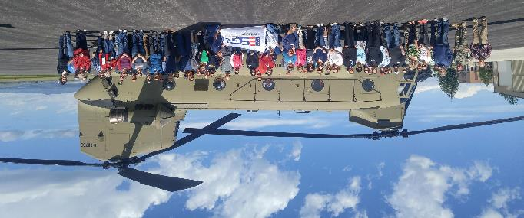
Q: Is an employer required to give a service member time off to go to drill.
A. Yes. With reasonable time to go to and from drill.
ESGR Boss lift Bozeman, MT

Slide 22
Discrimination
Q:Can I not hire a person in the service or who is considering joining? It sounds like a problem to let them come and go for drill weekends and annual training.
A: No- this is a hiring discrimination by denying initial employment because of future or current military service. USERRA Book Page 24
Notes:
Discrimination may include any treatment that occurs because you are in the military. Indicators are a pattern of conversations, missed promotions, or assignments made specifically to those in the military.
Initial hiring discrimination denying initial employment because of military service
HIRE! You want to hire service members as they are responsible, highly trained, and will show up to work drug free!

Slide 23
EMPLOYER RESPONSIBILITIES
Military obligations cannot be used as a motivating factor not to hire, promote or deny a pay raise.
Employer must…
Grant military leave of absence
Reinstate employee promptly
Restore seniority
Reinstate employment benefits
Retrain or refresh skills
Ensure no discrimination or retaliation occurs
Notes:
G/R members who meet the requirements for reemployment rights are entitled to the following USERRA protections.
Military Leave of Absence. Employers are required to grant employees a military leave of absence to perform military service.
Prompt Reinstatement. Service for 1-30 days, reinstatement will normally be the next work day. Service for 31 days or more, reinstatement will usually be no more than 2 weeks from the date of application. The position you are reinstated into will usually be the same job you left or if you were away for 91 days or more, a position of like seniority, status and pay.
Accumulation of Seniority. Also referred to as the ‘escalator principle’, this entitles you to the same seniority-based rights and benefits (including pensions) that you would have attained had you remained continuously employed. For pensions, service members have 3 times the amount of time they were deployed (up to 5 years) to pay any missed employee contributions to their pension plan.
Reinstatement of Health Insurance. Health benefits are reinstated immediately upon reemployment - no waiting period and no exclusion for pre-existing conditions. If service is 30 days or less R/G members can elect to continue coverage at the same cost prior to activation. If service is 31 days or more, R/G members can elect to continue coverage at a cost of 102% of the total employer cost.
PENSION CASE: If ESGR gets a pension case, they should immediately refer it to DOL. We can’t possibly solve it in 7 – 14 days. They are too complicated.
Training and Retraining. If you are no longer qualified due to technological advances or physical limitations, your employer must provide the necessary training to update your skills or retrain you into a new position.
Protection Against Discharge. For a limited period of time after returning from 31 days or more of military service, you cannot be discharged except for cause.

Slide 24
Reinstatement
Reinstatement/Job Placement: Reemployment reflects the “escalator” principal requiring each returning service member actually steps back onto the seniority “escalator” at the point the person would have occupied if the person had remained continually employed.
USERRA Book Page 14
Notes:
ESCALATOR PRINCIPAL- It is like they never left the job. They step off the escalator at one spot and step back on after their service at the seniority level they would have earned had they never left the office.
Job Placement/Reinstatement – getting placed back in the same or comparable position upon return from military service

Slide 25
Termination
Q: Is there any time a service member can be terminated?
A: Yes. Sometimes Service members are terminated during the deployment or upon an attempt to return to employment. In most cases this is illegal.
Exceptions occur if employees in similar positions who were not deployed were also terminated i.e. closing a company, division, or laying-off a formal group of employees. USERRA Book Page 17 and 24
Notes:
Termination – Sometimes Service members are terminated during the deployment or upon an attempt to return to work. In most cases this is illegal. Exceptions occur if employees in similar positions who were not deployed were also terminated. This includes closing a company, division, or laying-off a formal group of employees.
Even if the temporary person fulfilling their job is better at the job than the service member, you have to hire back the service member.

Slide 26
OMBUDSMAN
Q: Who can help me with USERRA
questions?
A: Trained ESGR OMBUDSMAN
Provide information and answer questions
Serve as a neutral mediator on USERRA issues between service members and employers
ESGR does not enforce the law
Resolves nearly 80% of cases received, within average of 9 days
Unresolved cases sent to Veterans’ Employment and Training Service
Notes:
Ombudsmen are trained ESGR committee members at the local, state and national level who help R/G members resolve employer related problems.
Ombudsmen provide information to R/G members and to employers regarding their rights and requirements under USERRA. They are available to answer questions and clarify the law (USERRA).
They also are authorized to work with both parties to mediate conflicts between G/R and their employers due to military service.
ESGR ombudsmen help to resolve over 90% of the employer related issues they receive. Their objective is to eliminate misunderstandings and resolve difficulties in a spirit of cooperation at the lowest level possible.
Employers and service members can call the ESGR hot line to ask questions.
99.9 percent of the concerns are because of a lack of communication between employer and service member.

Slide 27
AS AN EMPLOYER
Know the law and your part as an employer
Communicate:
Ask your Service member for the yearly drill and training schedule as well as future deployments
Keep in touch with employee while gone
Learn about ESGR and how we can be a resource
Learn: Ask your employee to invite you to ESGR employer events
C130 flight with Montana Air National Guard
Helicopter flights or Boss lifts -6 per year rotating towns
Limestone Hills Training with the Army
Army Simulators at various locations
Notes:
Main rule: work with your employee on issues
Communicate regularly with your employee. Ask for their drill, training and future deployment schedules.
Learn: Your service member can invite you to employer events such as helicopter or C130 flights; Limestone Hills Bradley or Tank firing trainings; simulator events at armories across MT..

Slide 28
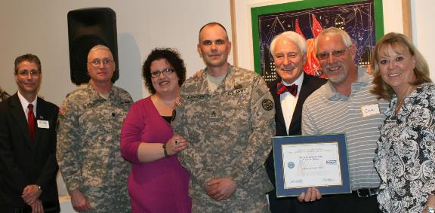
USERRA RESOURCES
USERRA Flip book provided today
Links to free online USERRA training at www.ESGR.mil
ESGR can provide free USERRA training for your business
Spouse Patriot Award presented to Green Up in Helena. Spouse of Service Member nominates their boss in thanks for their support of spouse’s military service during drill weekends, deployments and military obligations.
Notes:
USERRA Flip book provided today
Links to free online USERRA training at www.ESGR.mil
ESGR can provide free USERRA training for your business
Spouse Patriot Award present on behalf of spouse of a guard member to Green up in Helena MT in thanks for their support of her during her husband’s deployments and military obligations.

Slide 29
https://esgr.mil/Employers/Military-Service-Requirement-Support

Slide 30
USERRA QUESTIONS
ESGR National Website: www.ESGR.mil/USERRA
ESGR HOTLINE
(800) 336-4590, option #1
Other USERRA information
www.dol.gov/vets/programs/userra/

Slide 31
USERRA QUESTIONS
COVID 19

Slide 32
Top 10 Reasons to Hire Guard & Reserve
10. Global Perspective
9. On-Time, All the Time
8. First Class Image
7. Calm Under Pressure
6. "Can Do" Attitude
5. Physical Conditioning
4. Mission-Critical Skills
3. Responsibility
2. Professionalism
1. Leadership.
+ 1 Drug Free
Notes:
Top 10 reasons plus 1
DRUG FREE always a plus for employers

Slide 33
HOW TO HIRE
List jobs for free at www.ebenefits.va.gov/ebenefits/jobs
Network with MT Department of Labor Job Service offices providing employers labor market counseling, interview and job seeker selection tips, a vast job seeker network, and subsidies for hiring Veterans.
Send ESGR jobs to post for Guard and Reserve viewing. Email to parker.f.sullivan.ctr@mail.mil
Notes:
www.ebenefits.va.gov/ebenefits/jobs employers can list jobs for free
Send job openings with job descriptions to Montana ESGR we can post statewide.

Slide 34
Serving Our Military Community Worldwide
Free Employer Assistance Program for your
Military Employees & Families
Free Consultations:
Non-medical counseling – 12 sessions
Financial Counseling
Year-round tax consulting
Health & wellness coaching
Specialists
MilTax – free tax prep & filing
Tools & Resources: Education, Careers, Parenting, Retirement & more
Toll-free telephone 800-342-9647
www.MilitaryOneSource.mil
with live chat
www.MilitaryOneSource.mil
Interaction with trained professionals
Tabitha Garvin-Betancourt, state consultant (Helena) Tabitha.garvinbetancourt@militaryonesource.com (406)781-4986
Notes:
Military OneSource is a Department of Defense program providing an Employee Assistance Program for all those who serve in the military and their dependents (spouse/minor children): Active Duty, National Guard, or Reserves.
A FREE resource tool for employers to direct their military employees to.
Military OneSource provides:
Free non-medical counseling (up to 12 sessions per issue),
Financial Counseling,
Year-round tax consulting,
Health & wellness coaching, and other specialists.
Military OneSource saves military families money by offering an online tax preparation and filing program called MilTax. The website also contains a wealth of resources and tools on topics affecting all areas of a military families life: education, careers, parenting, retirement, and more.
Direct your military employees to access these services by calling the toll-free number 800-342-9647 or accessing the website at www.militaryonesource.com.
Employers who would like more information on this program or would like training for their HR or military employees can contact the Montana State Consultant, Tabitha Garvin-Betancourt.

Slide 35
Montana ESGR Contact
Great Falls ESGR
Parker Sullivan
406-791-0895
parker.f.sullivan.ctr@mail.mil
120th Airlift Wing
2800 Airport Avenue B
Great Falls MT
Notes:
Thank you for your time.
USERRA Hotline # 1-800-3364590 OPTION 1
Volunteer Support Specialist Parker Sullivan Great Falls at the 120th Airlift Wing in Great Falls.
Please don’t hesitate to contact Montana ESGR if you have a question or if anything comes up.

