Slide 1
Montana REGISTERED APPRENTICESHIP PROGRAM
Terry Aubrey
taubrey@mt.gov
406/559-7417
APPRENTICESHIP.MT.GOV
406/444-4100
Notes:
The Montana Registered Apprenticeship program is housed within the Montana Department of Labor and Industry.
Apprenticeships provide a career pathway to higher wages.
Since 2013, apprenticeships have grown almost 30% with the average wage of a trainee being $38,000. A journeyman earns almost $53,000 annually.
Currently almost 100+ occupations are available across Montana in a variety of industries with more programs being added each month.

Slide 2
Today’s World
There are no Qualified Workers!
We want a career!
This Photo by Unknown Author is licensed under CC BY-SA
This Photo by Unknown Author is licensed under CC BY-NC-ND
Notes:
You are not alone
Montana is facing a workforce shortage across all industries due to an aging and retiring labor force.
Over the next decade, the Department of Labor and Industry projects the labor force will grow by 4,500 workers each year, but our economists expect employment gains to reach approximately 7,300 new jobs each year. (-2,800)
Where others see obstacles, we see opportunities to train our existing workforce to provide different avenues for new workers to join the labor force.
Apprenticeships are one of the cornerstones that can help address our workforce shortage.

Slide 3
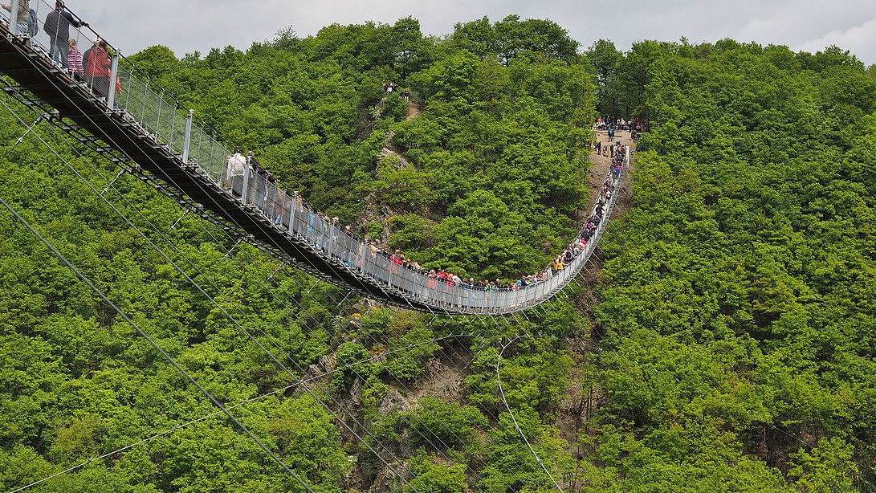
A perfect World
Notes:
Employers: Easy access to the people with the skills needed.
Unemployment Rate 4.4%. Employers must find innovative ways to recruit and train qualified employees.
World changing fast-skills needed changing
Increased retirements
Need is NOW
Job Seekers: Has Transferrable skills or want to attain skills Where are the opportunites?
Re-entering workforce: Layoff, coming out of retirement, changing careers…
High School: Who is hiring and willing to train me?
Want to LEARN and EARN…

Slide 4
Apprenticeship Connects
Notes:
Our TALENT pipeline-- the pool of candidates qualified for open positions is broken.
***APPRENTICESHIP IS THE CONNECTION!!!
It’s not just for Plumbers and electricians anymore! EXPANSION
MT 100+ Occupations
Accounting, IT, Healthcare, Manufacturing, Child care, Automotive, Welding, Brewing, Hotel Management,

Slide 5
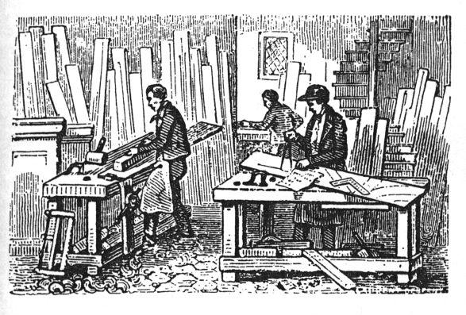
Apprenticeship
The Oldest Way To Learn
Notes:
Apprenticeship is a highly customizable, earn-while-you-learn training program used for centuries.
Active method of learning since 1300, because it was the best way to hand down specific, technical knowledge. Apprenticeship takes an individual and trains them in your business.
Started in Montana in 1941, and we have seen it grow,

Slide 6
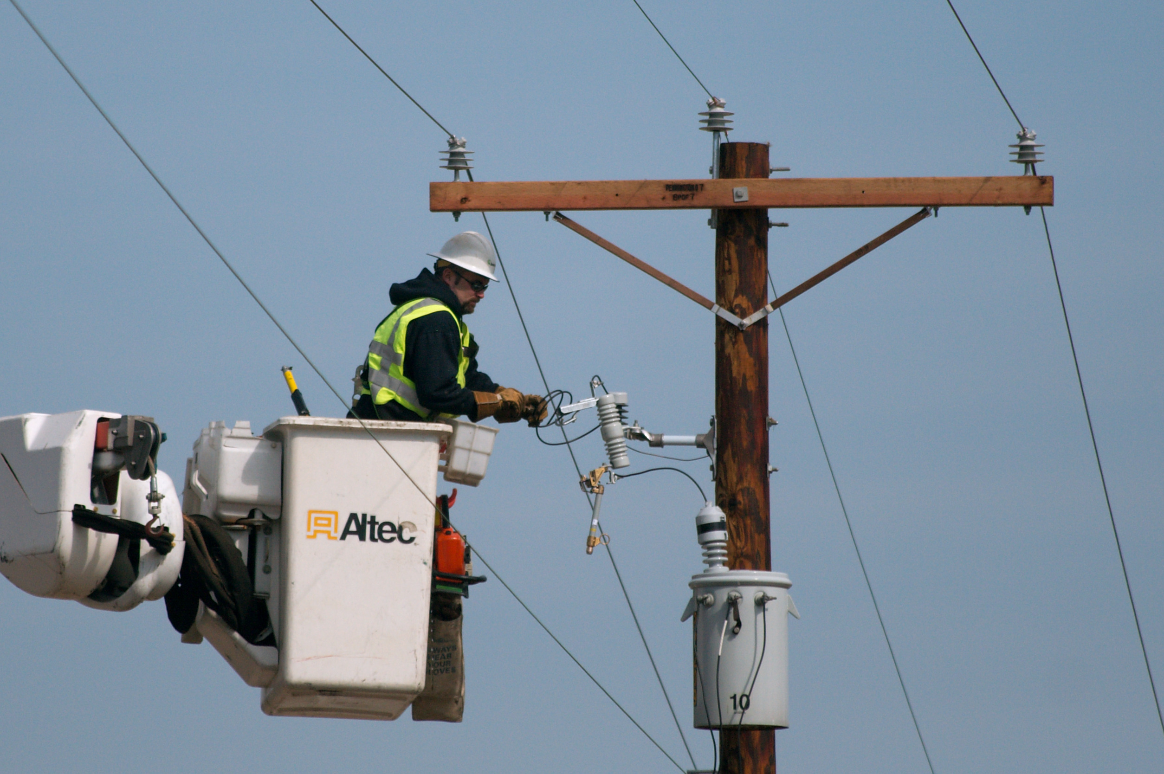
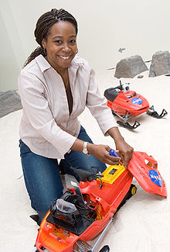
occupations
This Photo by Unknown Author is licensed under CC BY-SA
This Photo by Unknown Author is licensed under CC BY-NC-ND
This Photo by Unknown Author is licensed under CC BY
This Photo by Unknown Author is licensed under CC BY-SA
This Photo by Unknown Author is licensed under CC BY-SA
This Photo by Unknown Author is licensed under CC BY-NC
This Photo by Unknown Author is licensed under CC BY-SA
This Photo by Unknown Author is licensed under CC BY-SA
Notes:
Business
Health care
Construction
Manufacturing
I T
Plumbing
Electrical
Automotive
Hospitality

Slide 7
Working Definition of Registered Apprenticeship (n) employer designed training, consisting of not less than 2000 hours (1 year) of On the Job Training, and not less than 144 hours of related coursework.
*Training is designed to teach specific technical job skills unique to the employer’s profession.
Notes:
Definition of registered apprenticeship.

Slide 8
Notes:
1 and 2: The two main components of apprenticeship are on-the-job learning and related technical instruction through an educational partner such as a two-year college or training facility.
3: The Montana Dept. of Labor and Industry and Office of the Commissioner of Higher Education aligned to established Industry Driven Workforce Development Partnerships.
These partnerships have been instrumental in successfully providing Montana’s workforce new avenues to increase career pathways and increase data-driven workforce development strategies.
4: As apprentices move through their training program, they receive incremental wage increases.
5: In many cases, the apprentice will receive a nationally recognized industry credential from the Montana Department of Labor and Industry.

Slide 9
A Smart
Business Decision!
Provides Skilled Workers
Promotes Employee Retention
Increases Employee Commitment
Lowers Cost By Increasing Productivity
Boosts Competitive Advantage
Improves Service And Product Quality
Notes:
WHY?
Apprenticeship is a good value for a business,
Because, let’s face it, if it doesn’t add to a business’s bottom line, it’s never going to fly.
Here are a few reasons why apprenticeship is a good value

Slide 10
A Smart
Education Decision!
Provides Real Employment Skills
Builds A Career
Leaves No College Debt
Notes:
For the APPRENTICE

Slide 11
Under-Utilized in Montana
And We Don’t Know Why!!!
Notes:
Expansion Grant:
In 2016, the State of Montana received a 1.3 million dollar grant from the U.S. Dept. of Labor to expand infrastructure and outreach capabilities for the Montana Registered Apprentice program.
These funds were used to:
Hire more staff statewide to work with union and non-union businesses across the state launch new apprenticeship programs.
Significantly increase awareness about the value of apprenticeships through social media.

Slide 12
$$$ FUNDING SUPPORT $$$
Tax Credit $750/$1,500
IWT Incumbent Worker Training
WIOA Federal Grant OJT
WOTC Work Opportunity Tax Credit
Notes:
Apprenticeship Tax Credit:
The 2017 Montana Legislature passed the apprenticeship tax credit to provide businesses financial incentive to launch new or expand current registered apprenticeship training programs;
$750 tax credit for each new apprentice, or;
$1,500 tax credit for each new apprentice that is a veteran;
*Tax credit takes effect once apprentice has completed probationary period or after 6 months, whichever is earlier;
The tax credit maybe applied for each qualified apprentice’s training program for length of training program, up to five years;

Slide 13
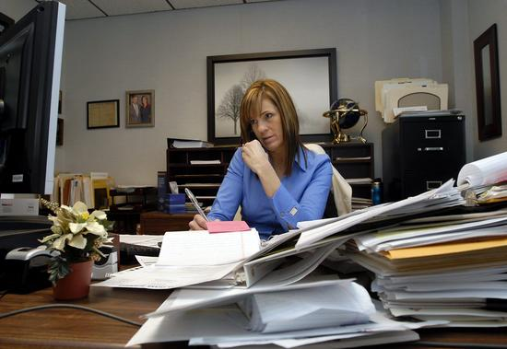
Get better results By training your own employees—apprenticeship begins by contacting our office.
Apprenticeship.mt.gov

Slide 14
Designing Training Programs for Montana Employers
Notes:
Apprenticeship is the CONNECTING PIECE.

Slide 15
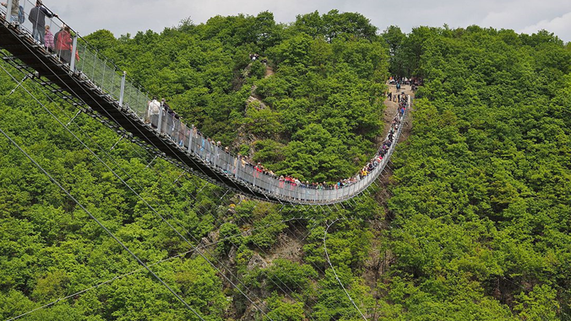
Apprenticeships – Customizable, Collaborative approach
Terry Aubrey
taubrey@mt.gov
406/559-7417
APPRENTICESHIP.MT.GOV
406/444-4100
Notes:
The Montana Registered Apprenticeship program is housed within the Montana Department of Labor and Industry.
Apprenticeships provide a career pathway to higher wages.
Since 2013, apprenticeships have grown almost 30% with the average wage of a trainee being $38,000. A journeyman earns almost $53,000 annually.
Currently almost 100+ occupations are available across Montana in a variety of industries with more programs being added each month.

